Slide 1

Azure Arc Overview

Slide 2




















Customer environments and application requirements are evolving
Single control plane with Azure Arc
How to govern and operate across disparate environments?
How to ensure security across the entire organization?
How to best enable innovation and developer agility?
How to meet regulatory requirements and overcome technical hurdles?
100’s–1,000’s of apps
Diverse infrastructure
Hybrid & Multi-Cloud
VMs
Databases
Datacenters
Hosters
Containers
Serverless
Branch offices
OEM hardware
IoT devices
Edge
Notes:
If you look at many of our customer’s environments today, it’s clear that they continue to grow in complexity with the influx of new technologies and platform investments. I’m sure this rings true for you as well.
Applications are running across a diverse infrastructure with data centers, hosting environments, branch offices as well as multi-cloud, where we see two or more clouds being used.
To add to this complexity, your teams are using different development tools, languages, and frameworks as well as approaches like Opensource, Kubernetes and DevOps.
Key questions I often hear as we meet with customers like yourself are :
How to govern and secure resources seamlessly regardless of where they are running?
How to bring cloud innovation to existing infrastructure?
How to modernize local datacenters with new cloud infrastructure?
How to extend compute and AI to the edge to unlock new business scenarios?
At Microsoft, we have long understood this reality you’d be facing. Microsoft Azure has been designed with hybrid in mind from the beginning to help you meet these challenges.
<CLICK>

Slide 3
Innovation anywhere with Azure
Hybrid and multicloud
Azure
Single control plane
with Azure Arc
Bring Azure services to any infrastructure
Modernize datacenters with Azure Stack
Extend to the edge with Azure IoT
Notes:
To support this momentum, Azure offers unique hybrid and multicloud capabilities that give customers the flexibility to innovate anywhere in their environment.
It’s starts with Azure Arc. Azure Arc enables you to standardize visibility, operations, and compliance across a wide range of resources and locations by extending the Azure control plane. Right from Azure, you can easily organize, govern, and secure Windows, Linux, SQL server, and Kubernetes clusters across data centers, edge, and multi-cloud.
Enabled by Azure Arc, you can bring Azure services to any existing infrastructure including other clouds you are using, so you can take advantage of cloud benefits everywhere, such as scalability, fast deployment, and always up-to-date cloud innovation.
You can build Azure-consistent new cloud infrastructure in your own datacenter with Azure Stack, so you can modernize your datacenter and run cloud native applications on-premises while taking advantage of existing investments and meeting regulatory compliances.
You can extend AI to edge devices with Azure IoT, so you can run machine learning and advanced analytics close to the users and the data. As a result, you can gain real-time insights and deliver immersive experiences at the edge of your network, opening up endless new business opportunities.
This is our portfolio of capabilities to support your hybrid and multicloud strategy.
Now, let’s dive into the steps it takes for you to successfully adopt a hybrid strategy.
<CLICK>

Slide 4

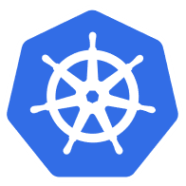

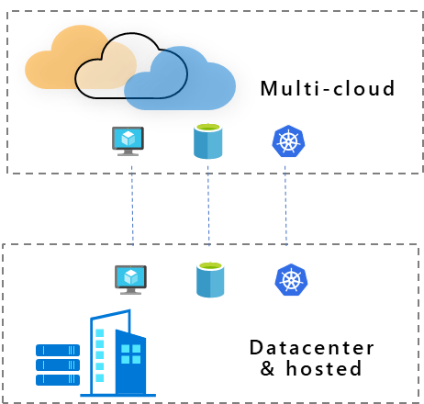

Azure Arc
Extend Azure management and services anywhere
Multi-cloud
Datacenter & hosted
Gain central visibility, operations, and compliance
Build Cloud native apps anywhere, at scale
Run Azure services anywhere
Azure is already trusted and proven by our customers. Azure Arc uses the same APIs and the same control plane as Azure, providing consistency across the hybrid infrastructure, which increases productivity and reduces risk.”
With Azure Arc, we can centrally manage multiple edge locations and help our customers grow and expand across the continent, creating more jobs and economic opportunities along the way."
For me, the main benefit is that my managers do not have to go to three different places to see the health of our database environment. I want to reinforce this over and over again because that’s what’s driving us.”
Notes:
With Azure Arc, you can benefit in 3 different scenarios. Arc helps you accelerate innovation across hybrid and multi-cloud environments with simplified management, faster app development, and consistent Azure services.
1) First, if you have workloads running outside Azure, you can centrally manage all these resources consistently in Azure, whether they are Windows, Linux, SQL Server or Kubernetes clusters. You can govern, organize, and inventory assets in a homogenous way and get central visibility to them from a single pane of glass, all from within Azure. This helps you meet governance, compliance, and organizational standards through policies for all your apps, infrastructure, and data.
2) Next, Azure Arc helps you build cloud native apps anywhere, at scale. You can leverage the modern cloud native app development practices, meaning you can use DevOps techniques to deploy and manage Kubernetes apps at scale on your choice of any certified Kubernetes distribution. You can also reduce errors with consistent configuration and policy-driven deployment and operations for applications and Kubernetes clusters. Use Arc to centrally manage and delegate access for DevOps roles and responsibilities.
3) And lastly, you can run Azure services such as Azure SQL Managed Instance and Azure PostgreSQL Hyperscale anywhere. With Azure Arc, you can implement cloud practices and automation to deploy faster, consistently, and at scale with always-up-to-date Azure Arc-enabled data services.

Slide 5



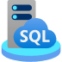






Single control plane with Azure Arc
Azure Arc-enabled infrastructure
Connect and operate hybrid resources
as native Azure resources
Azure Arc-enabled services
Deploy and run Azure services outside of Azure while still operating it from Azure
Multi-cloud
Datacenter
Edge
Notes:
So what exactly is Azure Arc and how does it work?
Azure Arc is a set of technologies that unlocks new hybrid scenarios for customers by extending Azure services and management to any infrastructure so that customers can build, operate, and manage all of their resources for traditional, cloud-native and distributed edge applications in a consistent way across the entire IT estate.
This means that you can now manage and operate all of your existing and new IT resources consistently and at-scale, wherever they reside, from Azure.
To unpack this a bit more, Azure Arc-enabled infrastructure enables you to connect your resources, which live outside of Azure today, and operate them as if they where native Azure resources, using the same management tools and services that Azure provides.
And with Azure Arc-enabled services, you have the flexibility to deploy fully managed Azure services anywhere – on-premises or in other public clouds so you can take advantage of cloud benefits everywhere, such as scalability, fast deployment, and always up-to-date cloud innovation. What’s awesome is that you can initiate and manage these deployments, right from the Azure Portal.

Slide 6





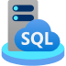


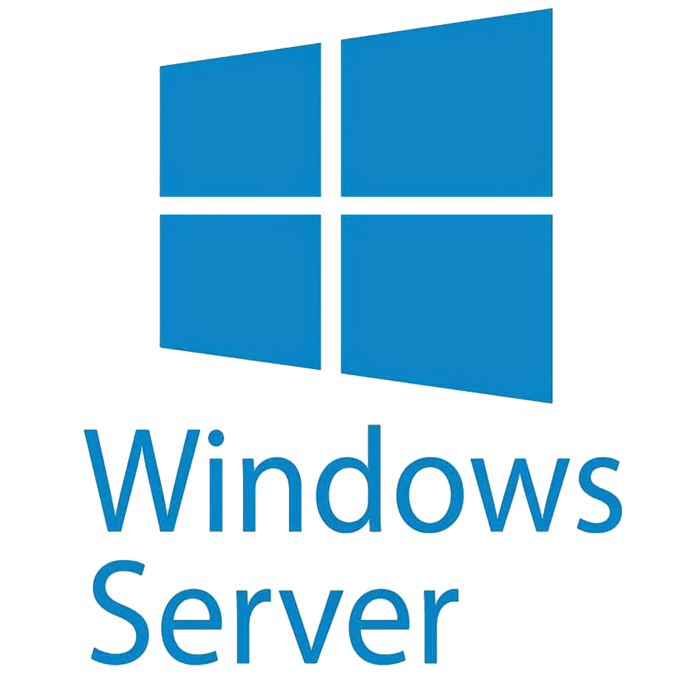


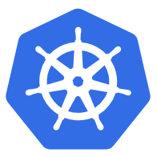







One consistent Azure platform for hybrid and multicloud
New slide, need design consistency
Azure Arc-enabled application services
Azure Arc-enabled data services and ML
Consistent Operations, Governance, and Security
Azure Arc-enabled infrastructure
Hybrid and Multicloud
Azure Stack HCI
Notes:
One of the goals of Azure Arc is to meet you where you are with your existing investments. As a developer, you get tremendous flexibility and convenience with Azure Arc enabled infrastructure and Arc enabled services. It doesn’t matter where your applications are running, they could be on servers, VMs or on Kubernetes. You can manage across all of these with Azure Arc.
If you have already container-based applications, you could easily deploy, secure and monitor all your deployments with Azure Arc enabled Kubernetes.
OR you could use Azure platform services like Azure App Services, Functions or data services like SQL Managed Instance for a more managed experience and deploy them in the cloud and in hybrid and multi cloud environment.
The important thing to note is that the way you deploy does not change. You could continue using your existing tools and practices and benefit from a seamless, consistent experience.

Slide 7


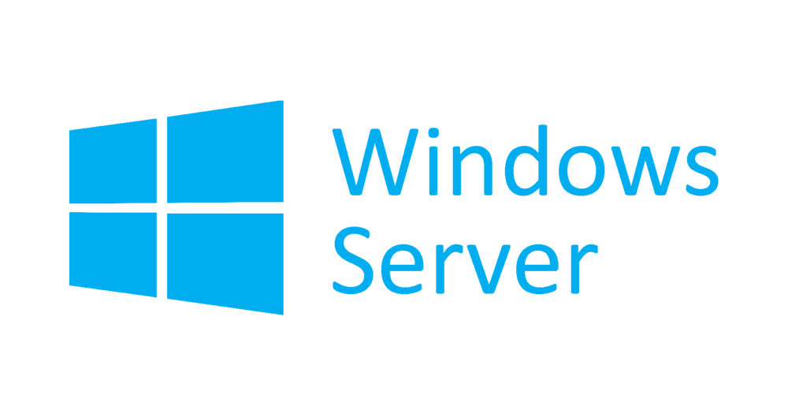





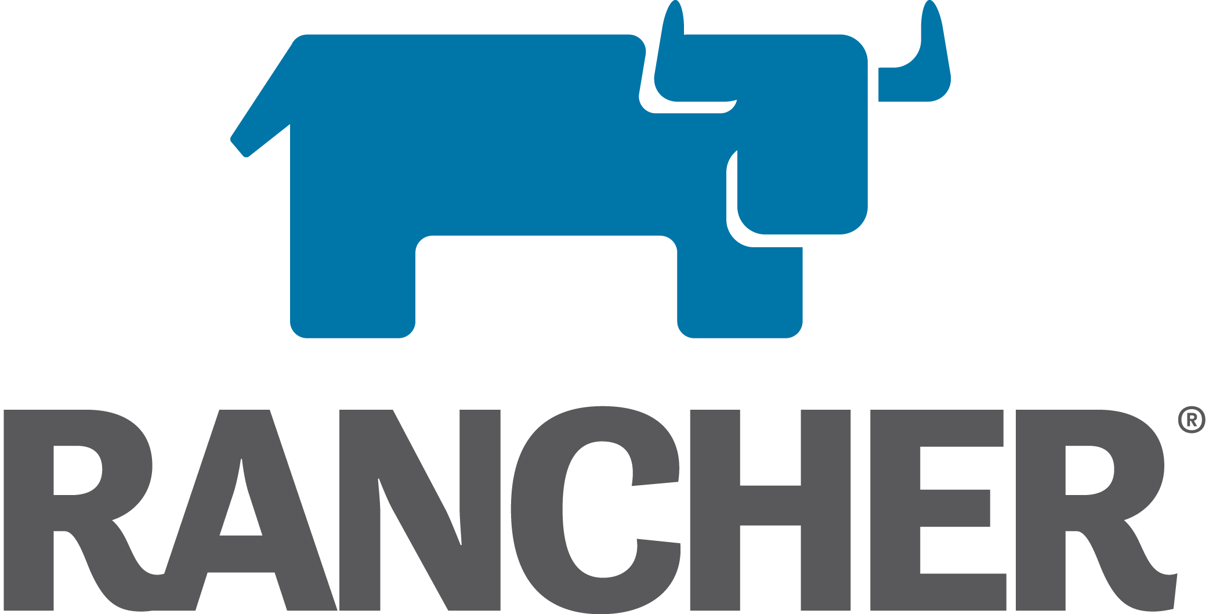


Azure Arc-enabled infrastructure Bring on-premises and multi-cloud infrastructure to Azure
Azure Arc-enabled servers
SQL Server on Arc-enabled
servers
Azure Arc-enabled Kubernetes
AKS on Azure Stack HCI
OpenShift
AWS Linux 2
GENERALLY AVAILABLE
PUBLIC PREVIEW
GENERALLY AVAILABLE
Notes:
So we talked about Azure Arc extending the Azure control plane to your existing infrastructure. Let’s take a closer look at Azure Arc-enabled infrastructure.
Let’s talk about what kind of Infrastructure services you can enable with Azure Arc – with GA of Azure Arc-enabled servers, we support Windows Server and a wide range of Linux operating systems such as SUSE and RedHat.
On Arc-enabled SQL Server, which is in public preview, in addition to the governance and inventory benefits, you are able to take advantage of additional value such as Azure Security services or proactive SQL assessments ensuring your databases are optimally tuned.
On Arc-enabled Kubernetes, we support a wide range of distributions, again offering you that flexibility of choice without forcing you to stick to a single solution. You can use cloud native tools practices and GitOps configuration and app deployment to one or more clusters at scale. We also announced the preview of AKS on Azure Stack HCI at Ignite which lets customers deploy and manage containerized applications on Azure Stack HCI, which can be managed by Azure Arc.

Slide 8

Azure Arc-enabled data services
Cloud experience for data workloads anywhere
GENERALLY AVAILABLE
Azure SQL
PUBLIC PREVIEW
Azure Database for PostgreSQL
Support all connectivity modes
Always current
As-a-Service
Elastic scale
Unified
management
Any hardware, any Kubernetes

Slide 9
Customer challenges when hybrid
Complexity
“I need to have health visibility in a single pane of glass to all my existing and future infrastructure and applications.”
Regulation
“Our DB layer must remain on-premises due to sensitive patient data and data availability needs.”
Compliance
“I need to manage security and incident management across my public cloud and datacenter assets.”
Latency
“We can’t take a dependency on the internet. If we lose connectivity, we still want to be able to access the data.”
Inconsistency
“I want my on-prem skills to work in the cloud, and my cloud skills to work on-prem.”
Legacy
“Our older systems take too much maintenance. We want evergreen technology and to pay for it like a utility.”
Multi-cloud
Datacenter
Edge
Notes:
Now that we’ve established hybrid is the norm for most customers today, let’s try to understand the challenges that customers are facing today with this model.
From an infrastructure point of view, we understand that some of this must remain on-premises. But it is complex, and we often hear customers say they need to have visibility into the health of all their existing as well as future infrastructure and applications in a single pane of glass. Second, from an IT point of view, while organizations understand the need for implementing a governance standard, they find it hard to integrate on-premises policies and updates with their cloud infrastructure. Third, since there are often different app development teams in the organization, there exists a wide range of skills across on-premises and cloud. Customers are looking for consistent inter-operability between the two so they can unify development practices.
Now, let’s also consider the deployment of cloud native services. Some customers operate in highly regulated industries (e.g. govt infrastructure, healthcare, FSI) where both internal and customer data are deemed critical and must remain within the boundaries of on-premises datacenters. There could also be a need for latency requirements where the data processing needs to happen close to the source of data while minimizing disruptions that may arise from internet connectivity issues. Another common scenario is that customers don’t want the management overhead of maintaining these services on-premises and would like to flip to a cloud billing model.

Slide 10
Azure Arc
Azure Arc-enabled infrastructure
Azure Arc-enabled services
Connect and operate hybrid resources as native Azure resources
Deploy and run Azure services outside of Azure while still operating it from Azure
Visibility
Bring distributed Windows, Linux, SQL and Kubernetes together a single plane of glass
Flexibility
Reduce risk and adhere to regulatory requirements by deploying cloud services on-premises
Compliance
Reduce risk and cost by establishing a single governance frame for all your workloads without additional overhead or additional approval processes
Latency
Deploy data services on-premises, close to your data sources with support for both disconnected and connected workloads
Consistency
Simplify the way you work by consolidating tooling and using cloud-native technology and practices everywhere
Always current
Get evergreen SQL and PostgreSQL Hyperscale on-premises with a cloud billing model
Multi-cloud
Datacenter
Edge
Notes:
With Azure Arc, we are helping you address these challenges.
(1) Azure Arc-enabled infrastructure enables you to have a single pane of glass view of all your resources – Windows, Linux and SQL Servers as well as Kubernetes containers so you have a better inventory of your IT assets. You can also reduce risk within your organization by establishing a governance framework and applying a standard set of policies for all your workloads. Server/app owners can now view compliance status of their own servers and take necessary remediation steps from the Azure Portal, This removes some of the management overhead on central IT in tracking and ensuring adherence to compliance standards. Lastly, Azure Arc also helps you adopt cloud practices on-premises – you can deploy applications using a consistent approach (familiar tools/practices) across all your Kubernetes clusters, on any infrastructure. You can standardize change control with declarative configuration management systems like GitOps and you can also easily adopt DevOps techniques, such as Infrastructure as code and empower developers with self service and a selection of tools.
(2) With Azure Arc-enabled services, you have the flexibility to deploy fully managed Azure services anywhere – on-premises or in other public clouds so you can take advantage of cloud benefits everywhere, such as scalability, fast deployment, and always up-to-date cloud innovation, while adhering to regulatory requirements.
These data services can be deployed and managed from within your on-premises environment or in your own customers’ regions, thus reducing the latency. Finally, you can access the latest Azure features and capabilities for on-premises data workloads. Today, in public preview you can deploy evergreen SQL (SQL Managed Instance) and PostgreSQL Hyperscale on any infrastructure and benefit from automatic updates, patches and upgrades without application downtime.
So how does Azure Arc actually work and achieve these things? To understand this better, let’s take a moment to ground ourselves on how Azure works <Click>

Slide 11

Azure customers
Develop & operate
Secure | Monitor | Protect | Automate | Develop
Tools and experiences
Inventory, Organization, Governance
Control
Extensibility for new resources
Servers | Kubernetes Clusters | Databases | etc.
Resources
Over 200 services
Azure Regions
Facilities
Notes:
A very important concept here is the Azure Control plane.
Customers connect to Azure using different tools or experiences such as the Azure Portal. What’s happening behind the scenes is that those tools and experiences are interacting with the Azure Control plane which is essentially Azure Resource Manager or ARM. Every single resource in Azure is connected to this control plane. Azure Resource Manager at its core, provides a core set of capabilities – inventory, organization and governance for Azure resources, which you can see on the slide (Servers/K8s/data services). As an example, when you want to a create a new resource in Azure, that request is received by the Azure Resource Manager, which then authenticates and authorizes the request. Resource Manager sends the request to the specific Azure service, which takes the requested action. So you essentially have a consistent tool for working with all your Azure resources. Once these resources are created, you can attach additional Azure Management services such as Azure Monitor, Azure Security Center to these resources. <Click>

Slide 12
Azure customers
Develop & operate
Secure | Monitor | Protect | Automate | Develop
Tools and experiences
Inventory, Organization, Governance
Extensibility for new resources
Control
Azure Arc
Servers | Kubernetes Clusters | Databases | etc.
Azure Arc-enabled infrastructure
Azure Arc-enabled services
Resources
Azure Regions
Facilities
Multi-cloud
Datacenter
Edge
Notes:
So what we did with Azure Arc is to extend this single control plane within Azure and those same capabilities , that we just talked about, to resources outside of Azure. This involves deploying an agent on the servers or Kubernetes clusters so these resources can be projected to the Azure Resource Manager. Once the initial connectivity is done, you can now see all these resources in the Azure Portal. You can group these resources, apply tags and RBAC policies as well as attach Azure management services such Azure Monitor, Azure Security Center etc., the same way as you would for Azure resources. So for IT admins, Azure Arc really brings that consistency and single pane of glass experiences to thousands of servers in customer environments.
A key point to add here is that you can continue to use your existing tools on-premises to interact with these resources, we are not interfering with any of those management tools.

Slide 13
Azure Arc
Extend Azure management and services anywhere
Multi-cloud
Datacenter & hosted
Gain central visibility, operations, and compliance
Build Cloud native apps anywhere, at scale
Run Azure services anywhere
Standardize visibility, operations, and compliance across a wide range of resources and locations by extending the Azure control plane. Right from Azure, you can easily organize, govern, and secure Windows, Linux, SQL Server, and Kubernetes clusters across datacenters, edge, and multi-cloud.
Centrally code and deploy applications confidently to any Kubernetes distribution in any location. Accelerate development by using best in class application services with standardized deployment, configuration, security, and observability.
Flexibly use cloud innovation where you need it by deploying Azure services anywhere. Implement cloud practices and automation to deploy faster, consistently, and at scale with always-up-to-date Azure Arc-enabled services.
Notes:
Now that we understand how Azure Arc works, let’s look at this with a few simple scenarios that Azure Arc helps you with and when to use it.
First, if you have workloads running outside Azure, you can organize all your resources consistently in Azure, whether they are on Windows, Linux, SQL Server or containers. You can govern and control them in a homogenous way and you can get visibility to them from a single pane of glass, all from within Azure.
Next, Azure Arc helps you build cloud native apps anywhere, at scale. You can leverage the cloud native app development practices, meaning you can use DevOps techniques to deploy and manage Kubernetes apps at scale and make sure they are configured consistently as you build your Kubernetes based applications. You can also standardize change control with declarative configuration management systems like GitOps, a popular Kubernetes operating model.
And lastly, you can run those Azure managed services, Azure SQL Managed Instance and Azure PostgreSQL Hyperscale anywhere. With Arc, you can implement cloud practices and automation to deploy faster, consistently, and at scale with always-up-to-date Azure Arc-enabled services.
Let’s look at a few real examples for each of these scenarios.

Slide 14
Azure Arc-enabled infrastructure Bring on-premises and multi-cloud infrastructure to Azure with Azure Arc
Azure Arc-enabled servers
Azure Arc-enabled SQL Server
Azure Arc-enabled Kubernetes
Organize, inventory, and monitor
Governance and Security
Simplified role-based operations
Physical, Virtual, Windows, Linux
Organize, inventory, and monitor
Governance and Security
Use with your existing SQL servers
Free SQL Assesment
Organize, inventory, and monitor
Governance and Security
Monitoring and Policy
GitOps-based zero-touch deploy
AKS on Azure Stack HCI
OpenShift
AWS Linux 2
GENERALLY AVAILABLE
PUBLIC PREVIEW
GENERALLY AVAILABLE
Notes:
So we talked about Azure Arc extending the Azure control plane to your existing infrastructure and we saw a real example where this scenario comes to life.
Let’s talk about what kind of Infrastructure services you can enable with Azure Arc – with GA of Azure Arc-enabled servers, we support Windows Server and a wide range of Linux operating systems such as SUSE and RedHat. On Arc-enabled SQL Server, which is in public preview, in addition to the governance and inventory benefits, you are able to take advantage of additional value such as Azure Security services or proactive SQL assessments ensuring your databases are optimally tuned.
On Arc-enabled Kubernetes, we support a wide range of distributions, again offering you that flexibility of choice without forcing you to stick to a single solution. You can use cloud native tools practices and GitOps configuration and app deployment to one or more clusters at scale. We also announced the preview of AKS on Azure Stack HCI at Ignite which lets customers deploy and manage containerized applications on Azure Stack HCI, which can be managed by Azure Arc.

Slide 15




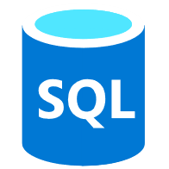
Customer scenario Gain central visibility, operations, and compliance
Hybrid & Multi-Cloud
Overview
A large financial institution has sprawling server-based IT systems deployed in corporate datacenters, hosters, and multi-cloud.
The sprawl is overwhelming, and it is impossible to manage and apply consistent governance across the environment and meet compliance needs
Business requirements
Manage a mix of bare metal, Windows and Linux servers across locations and disparate systems
Enable IT to apply at scale governance and security policies across all servers
Enable application owners to apply, audit and remediate compliance to meet their own requirements
Azure Arc
Azure Management
(Azure Resource Manager, Azure Policy, Azure Portal, API, CLI…)
Azure Arc
On-Premises / Hosted Datacenters
Notes:
Let’s look at the first scenario we talked about just now – Gain central visibility, operations, and compliance.
Consider this… We are working with a large financial organization with thousands of servers deployed in multiple locations. They are also using DevOps practices which result in an unknown number of servers that are connected to the corporate networks but do not conform to identity and governance requirements.
This customer really needs to gain some control of their environment and ensure the compliance requirements are met for audit purposes.

Slide 16
Customer scenario Gain central visibility, operations, and compliance
Hybrid & Multi-Cloud
Key benefits from Azure Arc
Asset organization and inventory with a unified view in the Azure Portal
Universal governance anywhere through Azure Policy
Centralized agent management – Monitoring, Security, Update Management and more
Built-in server compliance rules
Central compliance view across all servers
Self-service remediation
Integration with Azure Lighthouse
Azure Arc
Azure Management
(Azure Resource Manager, Azure Policy, Azure Portal, API, CLI…)
Azure Arc
On-Premises / Hosted Datacenters
Notes:
Let’s look at the first scenario we talked about just now – Gain central visibility, operations, and compliance.
Consider this… We are working with a large financial organization with thousands of servers deployed in multiple locations. They are also using DevOps practices which result in an unknown number of servers that are connected to the corporate networks but do not conform to identity and governance requirements.
This customer really needs to gain some control of their environment and ensure the compliance requirements are met for audit purposes.

Slide 17
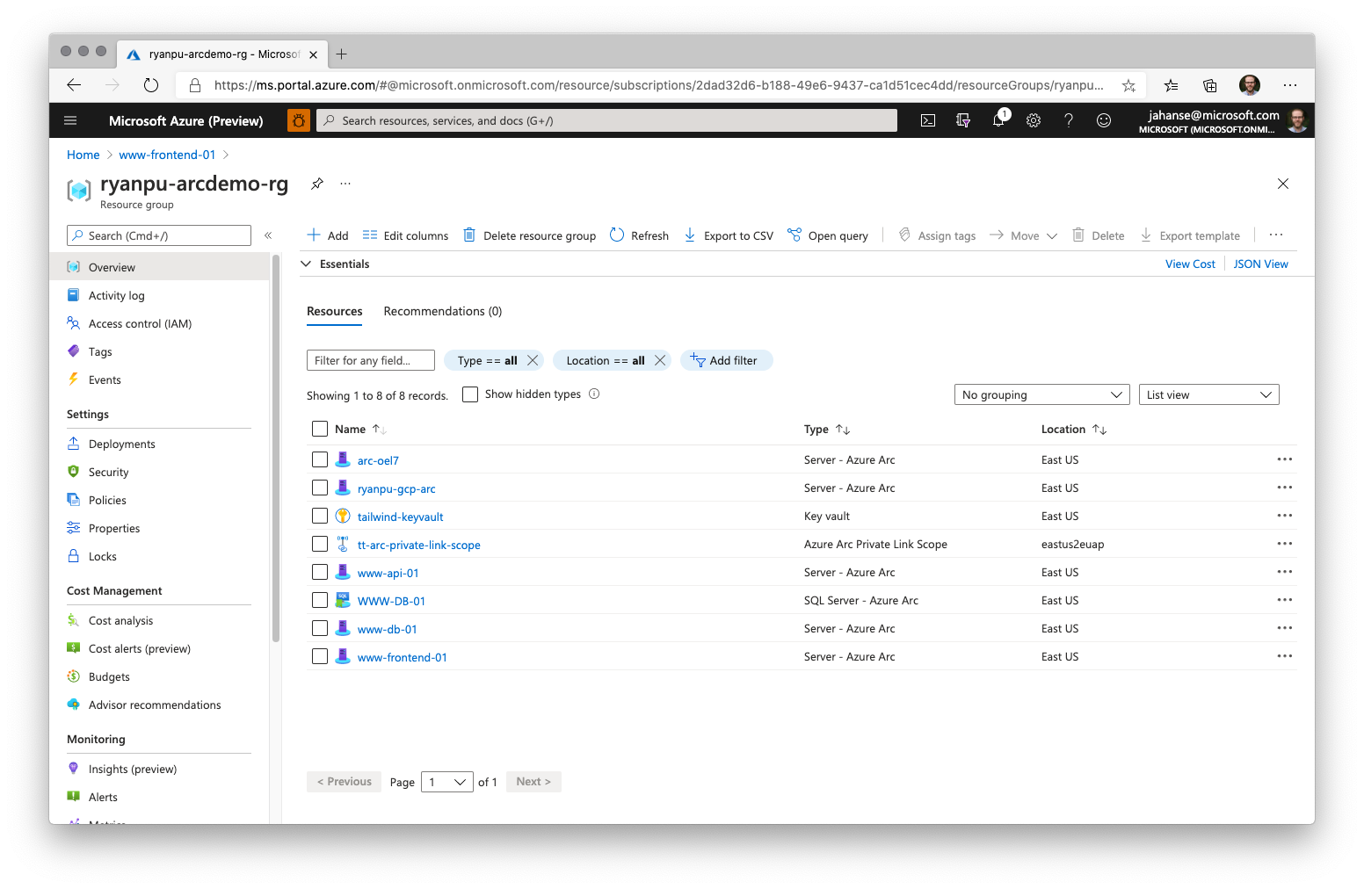

Slide 18
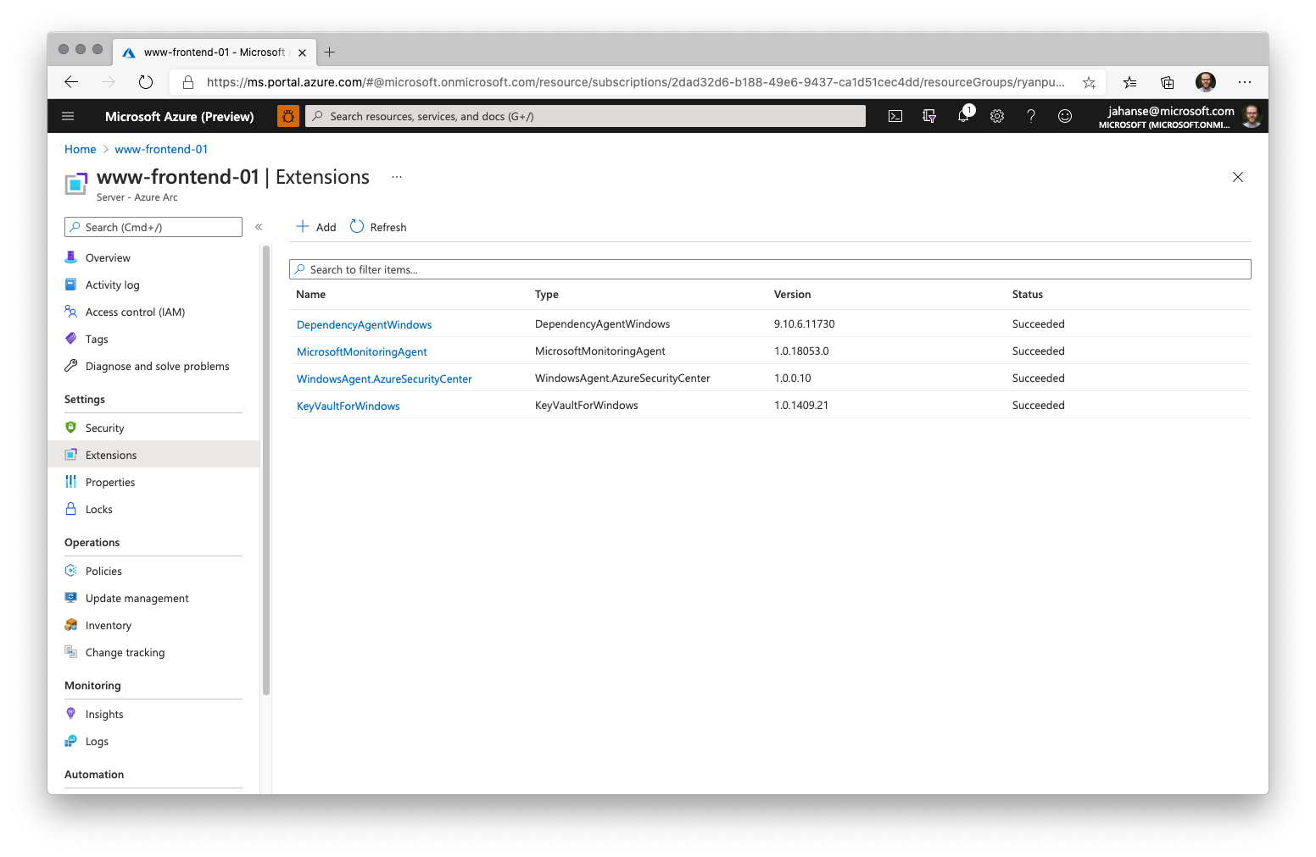

Slide 19
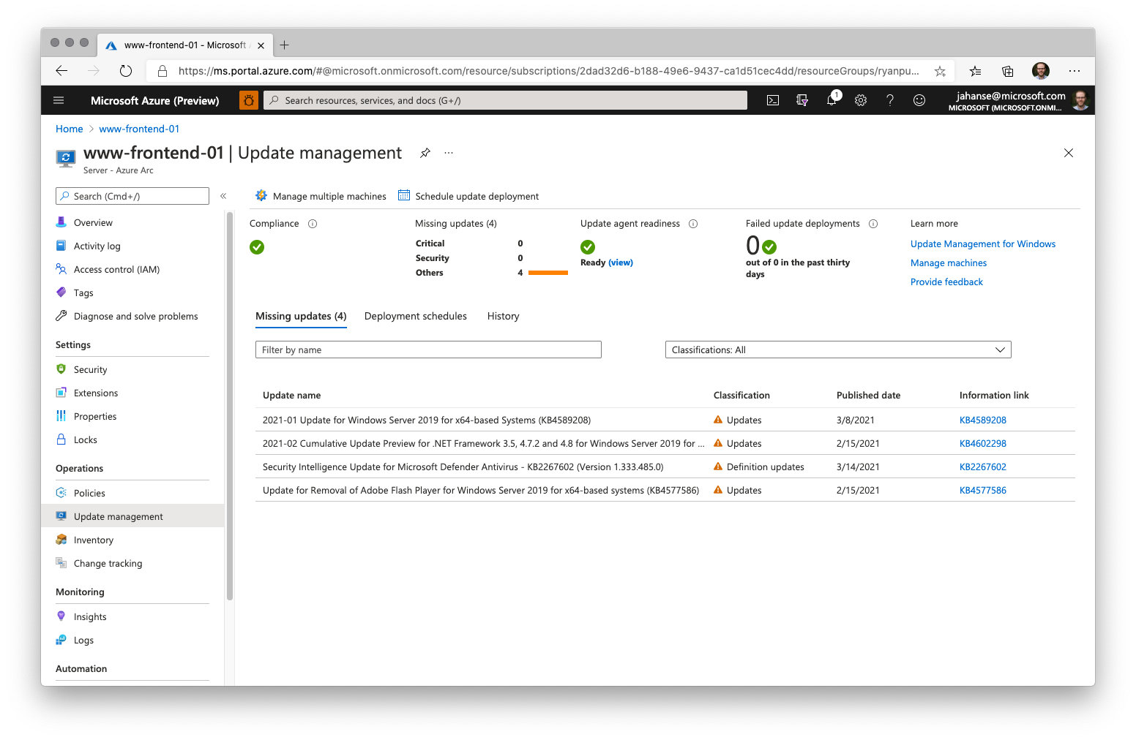

Slide 20
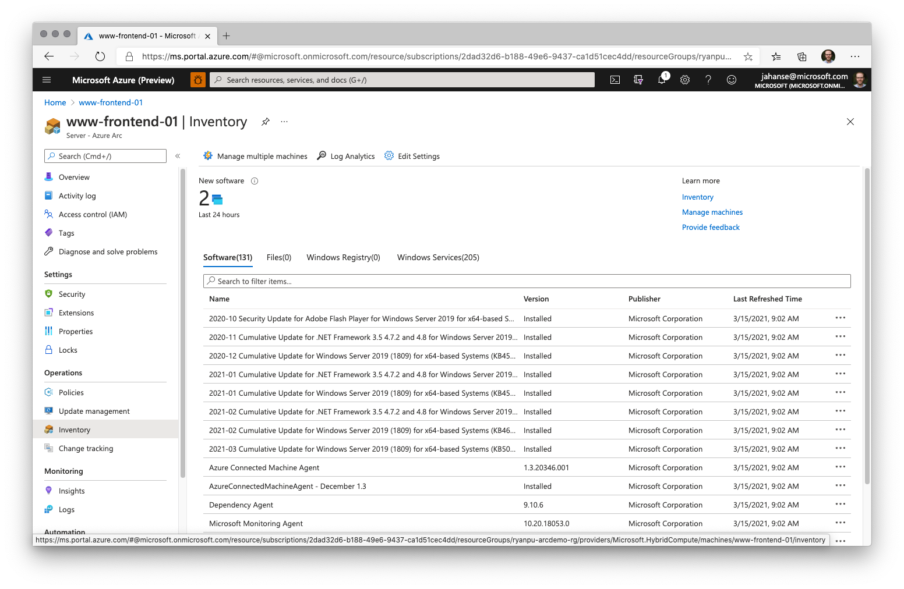

Slide 21
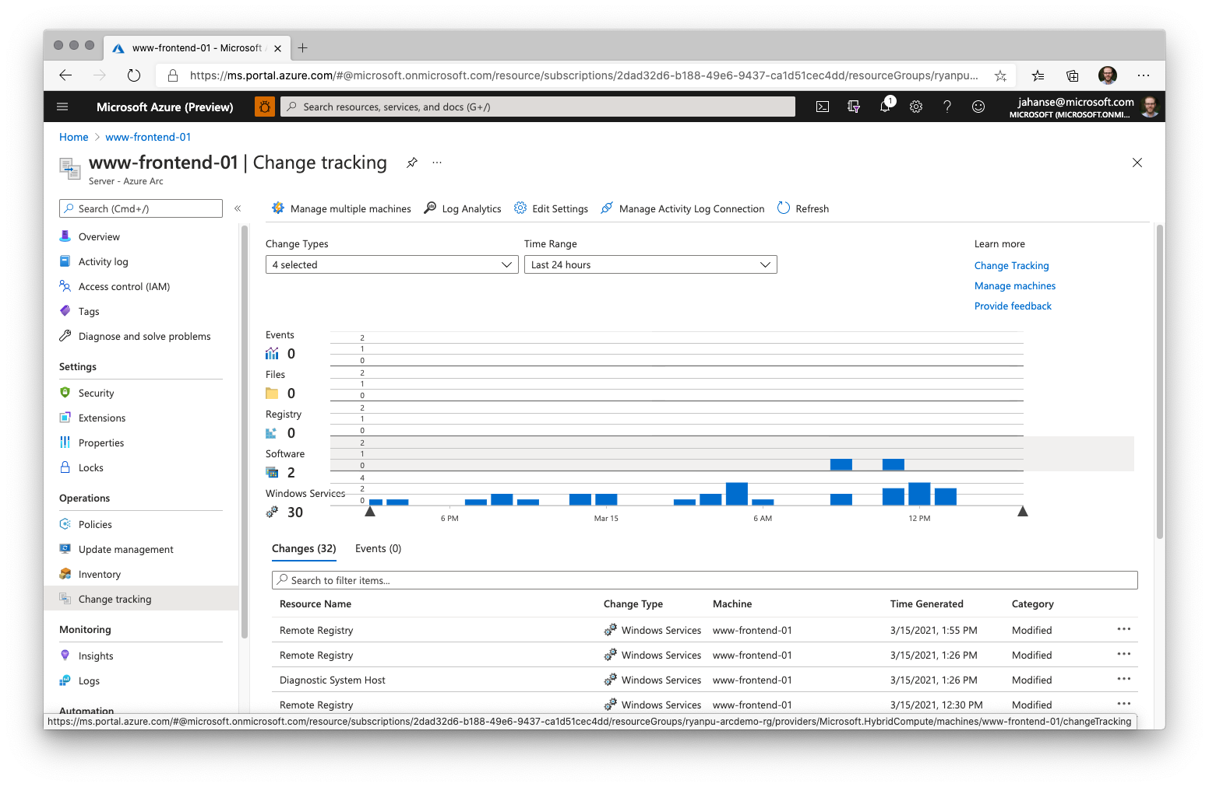

Slide 22
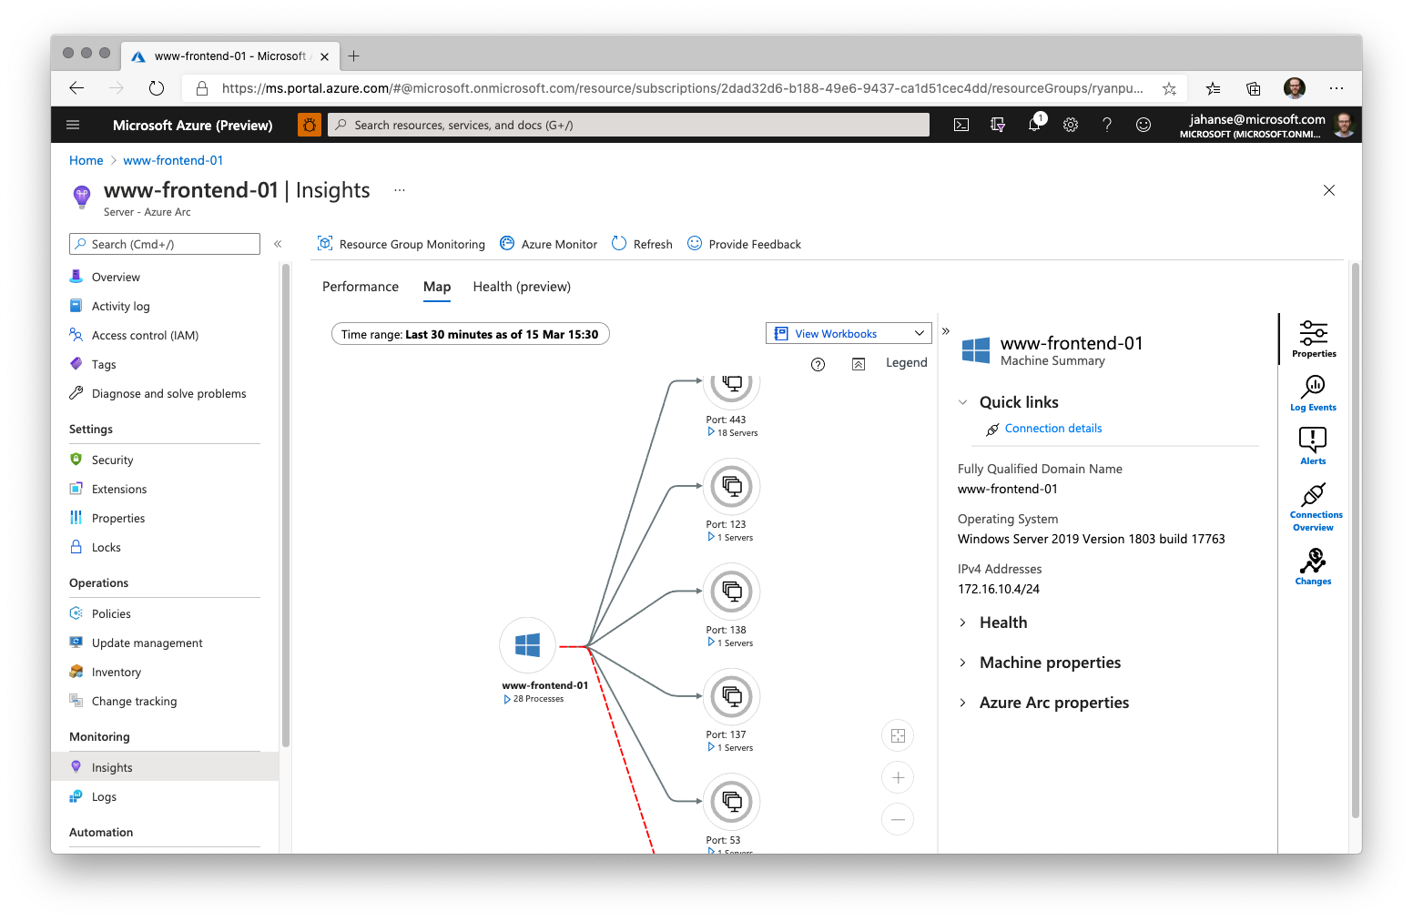

Slide 23
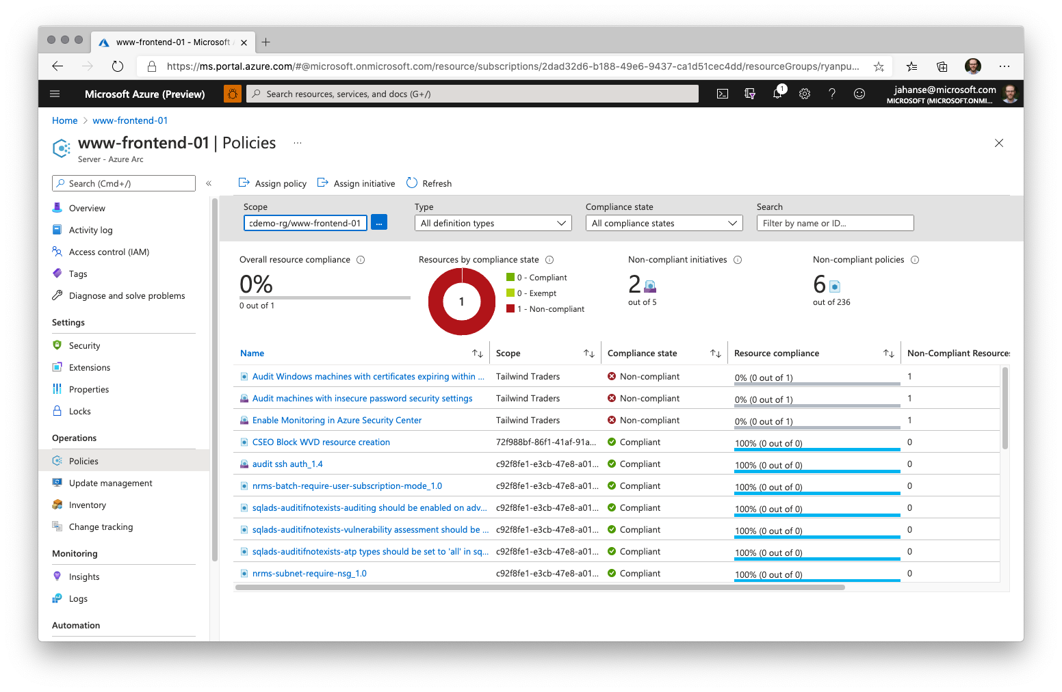

Slide 24
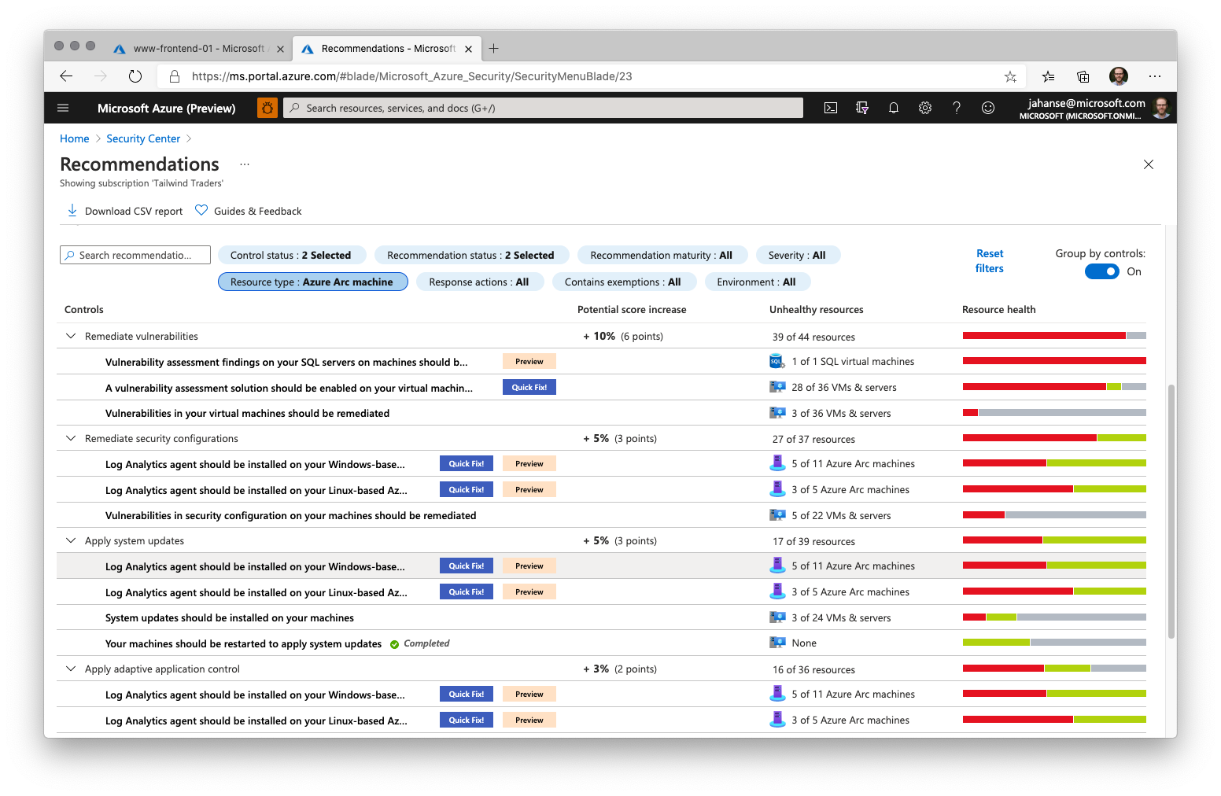

Slide 25
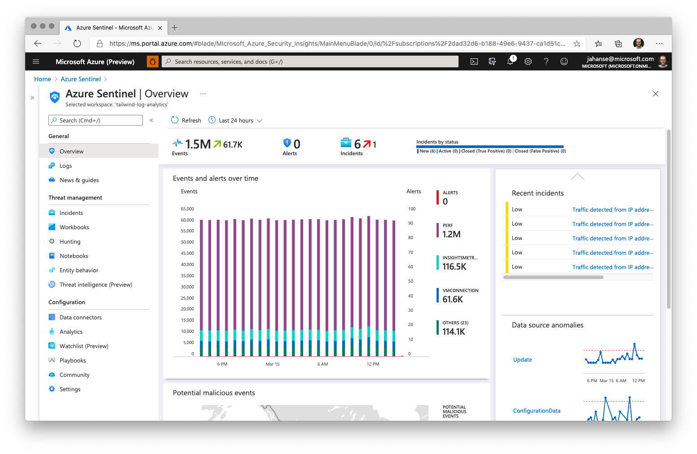

Slide 26



Azure Arc-enabled servers Bring on-premises and multi-cloud servers to Azure with Azure Arc
Reach
Organize and Inventory
Governance
Security
Built-in Azure policies
Compliance across environments
Centralized agent management – Monitoring, Security, Update Management
Azure Active Directory Managed Identity integration
Server security baselines
Role-Based Access control
Linux and Windows
VM and Bare-Metal
Domain agnostic
At scale searchable inventory
Unify management experience
Consistent VM extensions
Integrate with Azure Lighthouse
Any infrastructure, familiar tools
Notes:
So, just want to summarize Azure Arc-enabled servers for you.
You can onboard a wide variety of servers to Azure with Azure Arc – Windows, Linux, VM, Bare-Metal that are running anywhere. You can organize all these servers and apply governance across all these servers and apply role-based access control. In addition, you can also deploy Azure VM extensions to non-azure Windows and Linux VMs, simplifying the management of your hybrid machines on-premises, edge and other cloud environments. All of these capabilities are unparalleled in the market today.

Slide 27
Azure Arc-enabled servers Azure Arc-enabled servers are auto-enrolled with additional Azure services
Additional services
Azure Policy
Azure Defender
Azure Sentinel
Azure Monitor
Change and inventory tracking
Update management
Azure Security Center
AWS Linux 2
Just turn them on when you want to use them
Notes:
Remember, I talked earlier about how Azure Arc extends Azure management services to your non-Azure VMs? Well, a common question we get is : Which management services can I use with my Arc-enabled VMs. As you can see here, we have a variety of Azure management services, all of which can be applied to your Arc-enabled machines today.

Slide 28
Azure Arc-enabled servers The future of Microsoft Endpoint Configuration Manager (formerly SCCM)
The Azure management services enabled by Azure Arc can replace much of the functionality of MECM, but we recommend a gradual transition based on the use case. In some cases, MECM cannot be replaced yet.
On-Premises VMs
MECM
Azure Arc
Capabilities
Change and inventory tracking
Update/patch management
Security
Notes:
A popular question that gets asked in the context of Arc is if it is meant to replace SCCM (System Center Configuration Manager, now called Microsoft Endpoint Configuration Manager, MECM). SCCM is a popular systems management product developed by Microsoft that is predominantly used on-premises to manage Windows Servers.
The short answer to this question is ‘No’. Some of the capabilities of MECM can be achieved by different Azure management services, but not all. We recommend a gradual transition between the two based on the specific case as we’ll now see..<Click>

Slide 29
Azure Arc-enabled servers Co-management with Microsoft Endpoint Configuration Manager (MECM – formerly SCCM)
Use case | MECM | Azure management service enabled by Azure Arc
Software updates on Windows Server machines anywhere
Software updates on Linux machines anywhere
Software updates on your Windows clients (e.g., running Windows 10)
Software updates for on-premises systems which are behind an internet gateway
Server inventory and information collection
Run custom scripts on machines
MECM tracks and applies software updates to Windows Server machines in your organization
Azure Update Management uses the Log Analytics agent and can run on supported Windows Server OS for patch/update control
Azure Update Management uses the Log Analytics agent and can run on supported Linux distributions for patch/update control
N/A
MECM manages the deployment of software updates to clients in your organization
N/A
MECM can work with and configure cloud gateways. Boundary groups. Proxy etc. to manage the machines
Azure Update Management can work with the Log Analytics Gateway, to manage machines behind proxy and firewalls
MECM CMPivot can provide real time state of machines in the environment
Azure Automation Change Tracking and Inventory tracks changes in virtual machines and server infrastructure
Use Custom Script Extension in Azure or Process Automation in Azure Automaton to create and manage PowerShell scripts and workflows, Python scripts and graphical runbooks.
MECM has an integrated ability to run custom PowerShell scripts
Notes:
Use case Part 1.
Here is a quick map between the different use cases of MECM and the corresponding management service in Azure that offers the same capability. As you can see, sometimes there is a 1:1 map. For example, Azure Update Management can be used to manage software updates on Windows Server machines running anywhere, so you could potentially transition out of SCCM for this. But not everything has this 1:1 map. As mentioned, before MECM is used mainly for managing Windows Server and cannot be used to manage updates on Linux servers, Azure Update Management can be used for the same. Similarly, for managing Windows 10 clients, only MECM can help realize this use case, there is no equivalent service in Azure.

Slide 30
Azure Arc-enabled servers Co-management with Microsoft Endpoint Configuration Manager (MECM – formerly SCCM)
Use case | MECM | Azure management service enabled by Azure Arc
Create, manage and deploy applications on machines
Manage OS upgrades
Manage policies to mitigate malicious attacks and security vulnerabilities
MECM can manage deployment of applications and packages with automation built-in
Use Azure Custom Script Extension to deploy apps and packages to VMs, doesn’t have a UI like Software Center in MECM
MECM can deploy and update Windows via different methods and automate tasks
N/A
MECM manages policies for Windows Defender, Bit locker, VPN etc. to secure machines
Azure Security Center provides unified security management and advanced threat protection across hybrid cloud workloads.
Notes:
Another use case which only MECM is applicable for is Operating System Upgrades on your servers. This cannot be done today using any service in Azure. As you can see, the decision to move out of SCCM and adoption of an equivalent Azure service will depend on the use case you are looking to solve for.

Slide 31



SQL Server on Arc-enabled servers Data management benefits for Azure Arc-enabled servers
Flexibility
Management
Governance and Security
VMs and bare-metal servers
On-premises and multi-cloud
Searchable inventory
SQL Assessment service
Azure Policy
Azure Defender
No migration needed for existing SQL Servers
Notes:
Use the Azure Portal to register and track the inventory of your SQL Server instances across on-premises, edge sites, and multi-cloud in a single view.
Use Azure Security Center to produce a comprehensive report of vulnerabilities in SQL Servers and get advanced, real time security alerts for threats to SQL Servers and the OS.
Investigate threats in SQL Servers using Azure Sentinel.
Periodically assess SQL Server environment to receive actionable health guidance.
You can also govern across all your SQL Servers with built-in Azure policies to audit and secure your SQL Server estate.

Slide 32
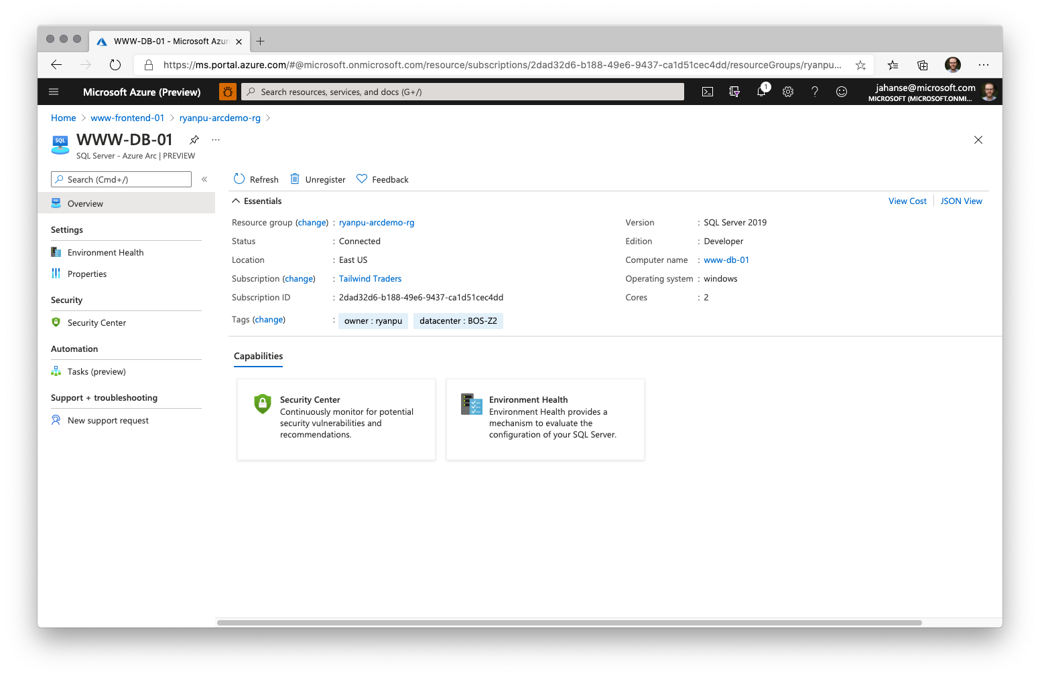

Slide 33
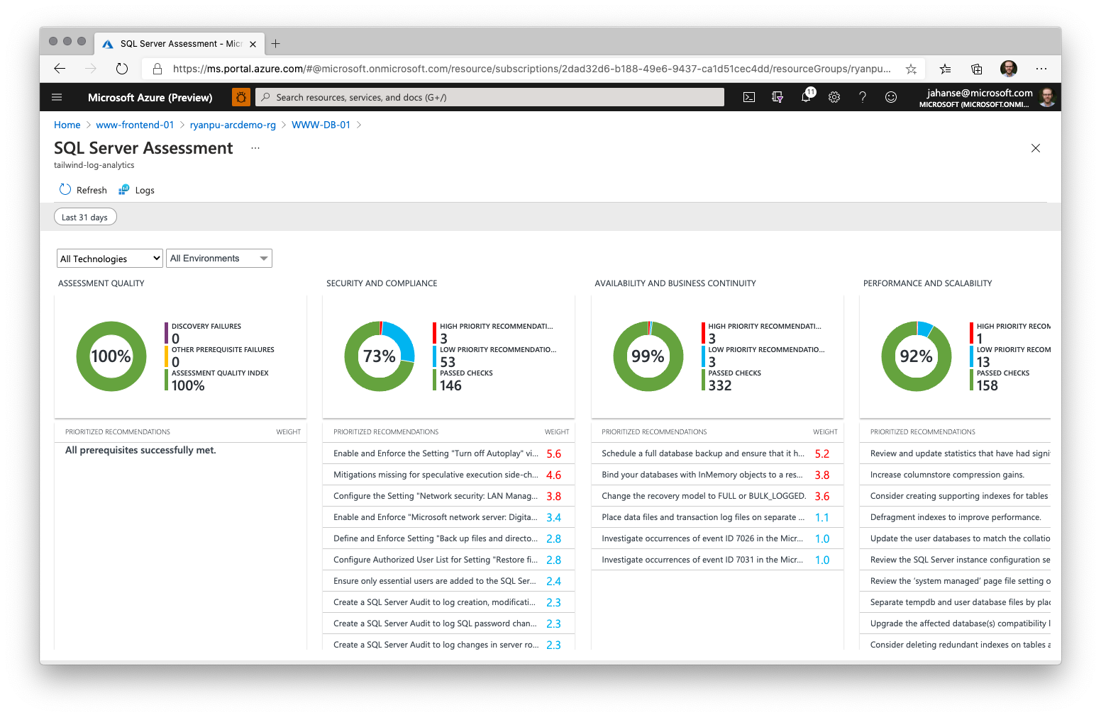

Slide 34
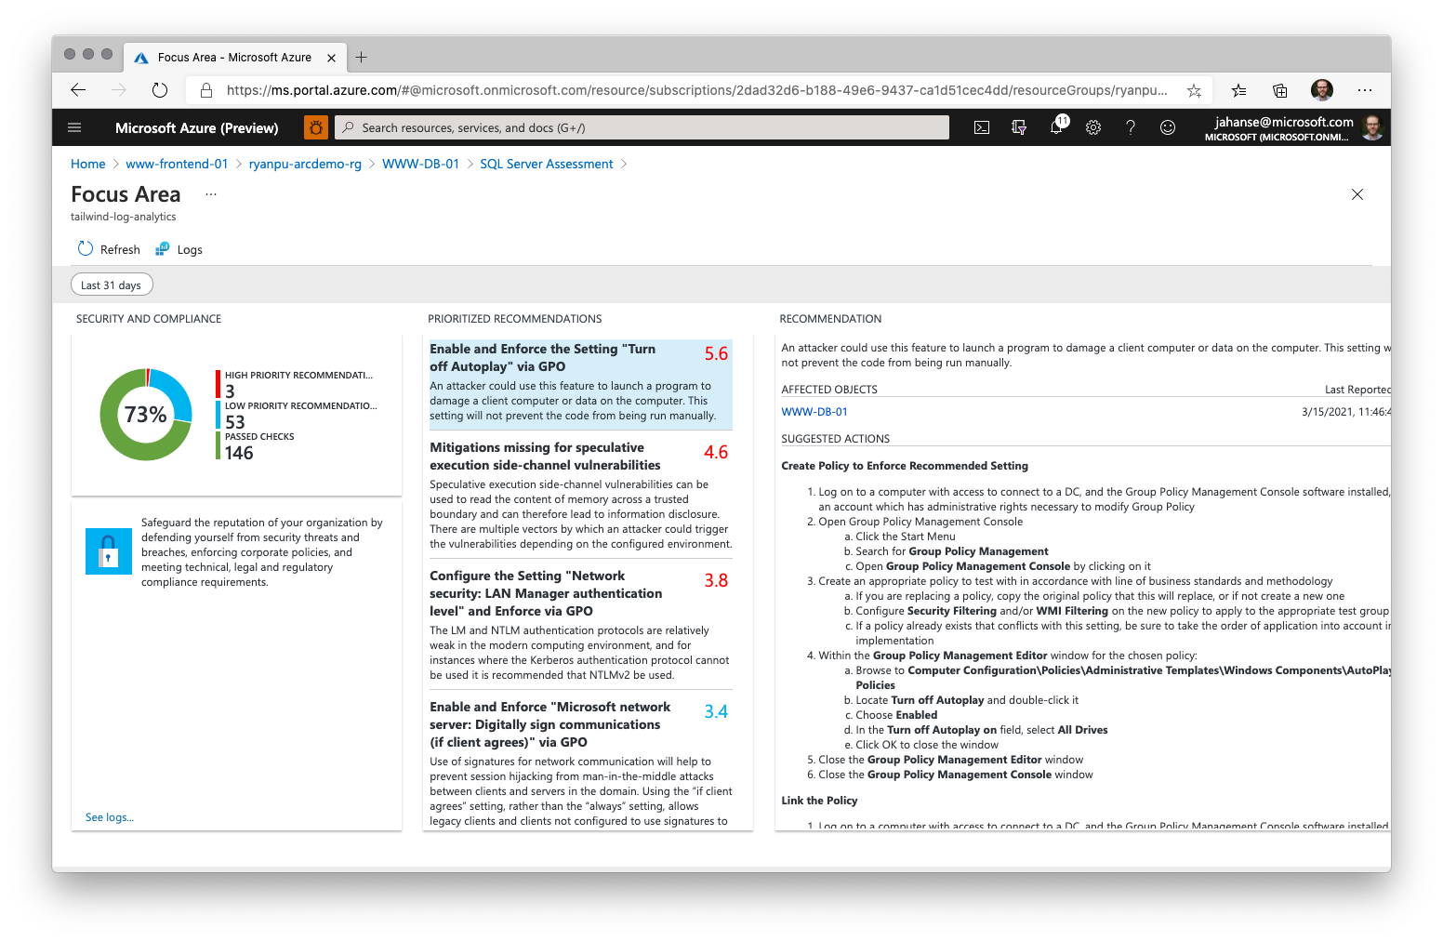

Slide 35



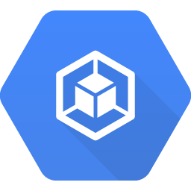



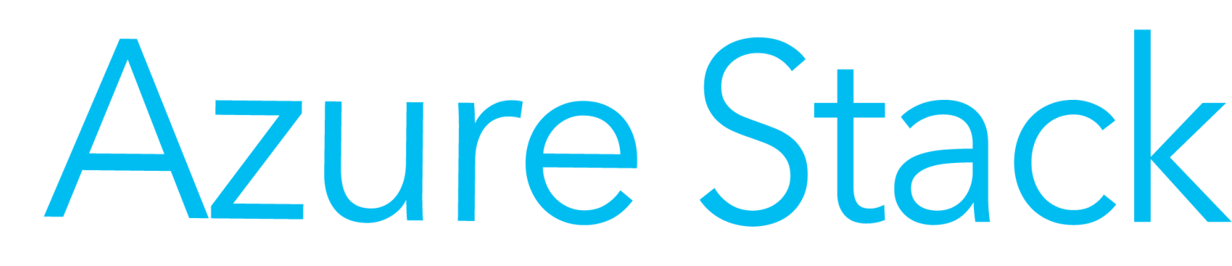
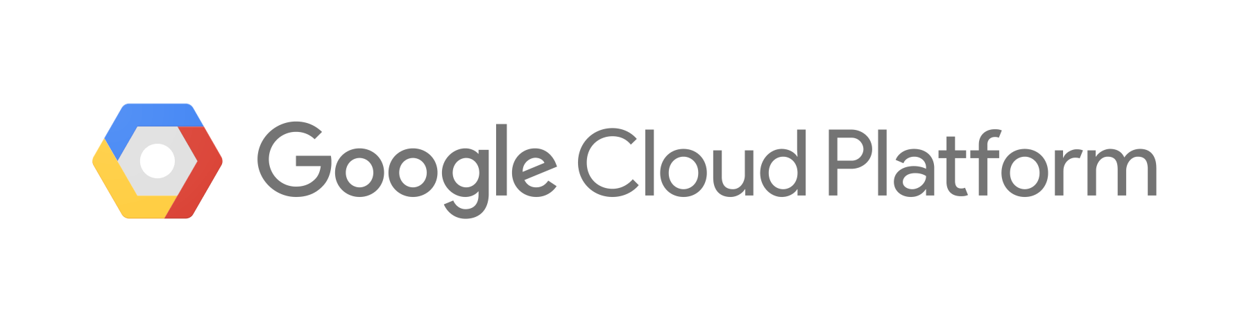
Azure Arc-enabled data services at a glance
Apps and BI
Custom apps
BI
Analytics
Azure Data Services
…
Azure Arc data controller
Provisioning
Updates
HA/DR
Backup
Scaling
Diagnostics
Azure Security Center
Azure Monitor
Azure Backup
Any Kubernetes
Kubernetes
OpenShift
AKS
EKS
GKE
VMware Tanzu
Any hardware
OEM hardware
Amazon EC2

Slide 36





Azure Arc-enabled data services architecture
Azure Portal
Azure CLI
Microsoft Container
Registry
Azure Data Studio
Deployments/Actions
Advanced Data Security
Resource Inventory
Billing
Logs & Metrics
Backup Retention
Azure Arc data controller
Monitoring and logs
Backup
Patching/updates
Controller
Azure Arc integration
HA/DR
Scaling
Provisioning
kubectl CLI
Database services
(Future)
Analytics services
(Future)
PostgreSQL Hyperscale
SQL MI
SQL MI w/ HA
Kubernetes API
Kubernetes
Node
Node
Node
Node
Node
Node
Persistent storage

Slide 37



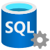
Azure full migration the default hero, Arc as secondary Decision tree based on customer needs
Operational data workloads
Can data go to Azure?
No (Hybrid as secondary)
Outside of Azure
Yes (Default hero)
Modernize in place
on existing apps
App modernization
/new apps
For customers who need
Retire data centers
Limitless scale, E2E security
IaaS, PaaS, Single DB, Pools
Fully managed with SLAs
For customers who need
SSRS/SSAS/SSIS
Server-based, not in containers
Specific versions of SQL Server for ISV apps
For customers who need
Operational databases
PaaS-like experience & cloud billing
Consistency and manageability across on-premises and multi-cloud
For customers who need
Small footprint SQL for IoT/ Edge compute
Streaming, time-series
To run on devices up to 8 cores
Azure SQL / OSS databases
SQL Server
Azure Arc-enabled data services
Azure SQL Edge
Any Windows/Linux servers
Any Kubernetes Cluster
Azure IoT Edge

Slide 38
Azure Arc-enabled data services: management comparison
Built-in Capabilities | Deployment Model
 | Customer Infrastructure |  | Azure
 | SQL Server / PostgreSQL | Azure Arc-enabled-data services | Azure PaaS databases
Database security features
Elastic / “Limitless” scalability |  | Limited by the capacity of customer infrastructure
Automatic HA/DR |  | Customer responsible for underlying HW/K8s availability
Auto upgrade, patching
Auto backup-restore
Monitoring
Compliance certifications | Customer responsible for compliance certification | Customer responsible for compliance certification | 90+ certifications
Data sovereignty |  |  | Azure regions not available in all countries yet
Customer control |  |  | Pre-defined HW options No control over HW/OS
Fully managed by Microsoft | Customer-managed | Customer-managed using software provided by Microsoft
Guaranteed availability SLA | Customer-managed | Customer-managed using software provided by Microsoft

Slide 39
Database engine feature comparison by deployment model
Deployment Model
Customer Infrastructure
Azure
Built-in capabilities
SQL Server
SQL Managed Instance - Azure Arc
SQL Managed Instance
Database security features – TDE, AE, RLS
Agent
In-memory OLTP
Columnstore
Intelligent Query Processing
Always On Availability Groups/HA
In-database Machine Learning Services
Preview
Compression
Partitioning
Replication
Graph

Slide 40
Management capabilities comparison by connectivity mode
 |  | Azure
Built-in capabilities
Connectivity Modes
Built-in capabilities
Indirectly Connected
Directly Connected
Automatic HA/DR
Self-service provisioning
Using Kubernetes tools, Azure Data Studio, or az CLI locally
+Using Azure Portal, Azure Policy, az CLI through ARM
Elastic / “Limitless” scalability
Using Kubernetes tools, Azure Data Studio, or az CLI locally
+Using Azure Portal, Azure Policy, az CLI through ARM
Billing
Export/upload to Azure. Some delay in visibility to costs incurred depending on upload frequency
Automatic, continuous feed of billing usage telemetry to Azure
Auto upgrade, patching
Container images must be pulled/pushed to a local registry
Container images come automatically, directly from Microsoft Container Registry
Auto backup-restore
Local backup/restore service for scheduled, frequent, fast backups and restores.
+Send backups to Azure Backup (future) for long-term, offsite retention
Monitoring
Local monitoring and log analytics. Manually export and upload to Azure Monitor.
+Auto send monitoring and logs to Azure Monitor. +Container Insights
Authentication
Kubernetes authentication
Active Directory for SQL endpoints
+Azure Active Directory
Role Based Access Control (RBAC)
Kubernetes RBAC
+Integrated with Azure RBAC
Inventory in Azure
Automatable or manual export/upload to Azure
Automatic sync to Azure
User experiences/tools
Kubernetes tools, Azure Data Studio, or az CLI locally
+Azure Portal, Azure Policy, az CLI through ARM
Security services
+Advanced Threat Protection (Future)
+Vulnerability Assessment (Future)
Items in blue text are optional, add-on Azure services with their own pricing model.

Slide 41



Azure Arc-enabled application services
PREVIEW
Run your apps, anywhere
App Service
Functions
Logic Apps
API Management
Event Grid
Cloud-native, at scale
Flexibility
Unified Management
Manage applications running on Kubernetes at scale with modern cloud native practices
Use the services you want with any CNCF-conformant Kubernetes cluster
Single view across hybrid and multicloud environments
Any Kubernetes, anywhere
Notes:
With Azure Arc, you can now run your favorite Azure application services anywhere, including on Kubernetes on Azure, on-premises, on the edge, and on other clouds such as AWS or Google. Any Kubernetes cluster connected through Azure Arc is now a supported deployment target for Azure’s application services.
Bdcs
Sdfs
sfds
With Azure Arc-enabled application services, developers don’t have to build and maintain custom solutions for their non-Azure environments. They can now build hybrid and multicloud applications using the portable application services powered by Azure Arc.

Slide 42
Azure Arc-enabled machine learning
PREVIEW
Build models on-premises, in multi-cloud, and at the edge with Azure Arc
Azure Machine Learning
Innovate rapidly
Operate efficiently
Unified Management
Use familiar tools
Meet regulatory compliance
Auto scale compute anywhere
Get started in minutes
No data movement
Leverage existing infrastructure
Single view for on-prem and clouds
Consistent workflows
Any Kubernetes, anywhere
Notes:
Azure Arc, now enables you to bring Machine Learning to any infrastructure across on-premises data centers, multi-cloud environments and at the edge, using Kubernetes.

Slide 43
Azure Arc pricing model
No additional cost
Control plane functionality:
Tagging, management groups, activity logs, templates, Resource Graph, RBAC
Customers’ servers and clusters
Notes:
Let’s take a look at the pricing model for Arc-enabled servers. So first, you have your own servers and clusters, you install the Arc agent on them. This basic connectivity to Azure is free of charge. In addition, we offer other control plane functionality at no additional cost – tagging, the ability to organize resources into management groups and subscriptions, RBAC and querying with Azure Resource Graph.
<One click>

Slide 44
Azure Arc pricing model
Azure Policy—guest configuration
Azure Monitor
Azure Defender
Azure Sentinel
Backup
Log Analytics
GitOps management for Kubernetes Application Insights
Config and Change Management
Additional services ($)*
Azure Arc-enabled services ($)*
SQL Managed Instance (preview, GA on 7/30)
PostgreSQL Hyperscale (preview)
Azure Machine Learning (preview)
App Service, Functions, Logic Apps, APIM, Event Grid (preview)
No additional cost
Control plane functionality:
Tagging, management groups, activity logs, templates, Resource Graph, RBAC
Customers’ servers and clusters
*Pricing for Azure Arc-enabled services and additional management services is consistent with Azure pricing.
Services are available at no cost during preview.
Notes:
So what gets charged then?
Firstly, any management service that you use with Azure
Any Azure management service, that you can see listed here, when attached to the server will be charged. The pricing model for these services will be the same as they are today for Azure VMs. For example, Azure Monitor for Arc-enabled VMs will be priced the same way as it would be for Azure VMs.
The only exceptions are Azure Policy Guest Configuration and Azure Automation services such as Update Management, DSC, Change tracking and inventory, which are free for Azure VMs but charged at $6/server/month for Azure Arc-enabled VMs. You could just use one of these or all of them together, the price remains at $6/server/month.

Slide 45
Azure Arc pricing details
 | Add-on management services | Azure Resource | Azure Arc Resource
Azure Arc control plane functionality (for both Arc-enabled servers and Kubernetes) | Onboarding, Resource organization in the Azure Portal, Tagging, Searching and Indexing, RBAC and Automation through Templates | Free | Free
Add-on management services (for both Arc-enabled servers and Kubernetes) | Azure Monitor, Azure Defender, Azure Sentinel | Refer to the pricing for the specific service in the Azure Pricing calculator | Priced similar to Azure resources. Refer to the specific service in the Azure Pricing calculator
Azure Arc-enabled servers | Azure Policy guest configuration (includes Azure Automation change tracking, inventory, state configuration) | Free | $6/Server/Month
Azure Arc-enabled Kubernetes | Kubernetes Configuration (GitOps) | N/A | First 6 vCPUs are free, $2/vCPU/month thereafter*
Azure Arc-enabled application services | App Service, Functions, Logic Apps, APIM, Event Grid | Refer to Azure pricing calculator | Free in preview. Pricing to be disclosed at GA
Azure Arc-enabled data services | SQL Managed Instance | Refer to Azure pricing calculator | Pricing varies by product tier. See next slide for details.
 | PostgreSQL Hyperscale | Refer to Azure pricing calculator | Free in preview. Pricing to be disclosed at GA
*If the Arc-enabled Kubernetes cluster is on Azure Stack Edge, AKS on Azure Stack HCI (>=April 2021 update), or AKS on Windows Server 2019 Datacenter (>=April 2021 update), then the Kubernetes configuration is included at no charge. More information on this can be found on the docs page.
Notes:
So what gets charged then?
For Arc-enabled servers: Any Azure management service, that you can see listed here, when attached to the server will be charged. The pricing model for these services will be the same as they are today for Azure VMs. For example, Azure Monitor for Arc-enabled VMs will be priced the same way as it would be for Azure VMs.
The only exceptions are Azure Policy Guest Configuration and Azure Automation services such as Update Management, DSC, Change tracking and inventory, which are free for Azure VMs but charged at $6/server/month for Azure Arc-enabled VMs. You could just use one of these or all of them together, the price remains at $6/server/month.
For Arc-enabled Kubernetes: Any number of Kubernetes clusters can be connected and organized in the Azure Portal at no additional cost. Like Arc-enabled servers, add-on Azure management services, like Kubernetes Configuration, are charged when enabled.
Kubernetes Configuration is an add-on Azure management services that deliver configuration management and application deployment using GitOps. The first 6 vCPUs are included at no cost. After that, $2/vCPU/month.
For Arc-enabled data services: In the current preview phase, Azure Arc-enabled data services is offered at no additional cost.

Slide 46
Consistent cloud billing model with Azure
General Purpose | Pay-As-You-Go | 1-year Reserved Instance | 3-year Reserved Instance
License included | $153 | $113 | $93
Azure Hybrid Benefit* | $80 | $40 | $20
Azure Arc-enabled​ SQL Managed Instance​
Pricing based on 1vCore/month. No minimum on # of vCores per instance
*Restrictions apply

Slide 47
What do we hear from customers?
“I need to manage security and incident management across my public cloud and datacenter assets through policy enforcement and automation.”
“As a Managed Service Provider, I need to operate and govern my customer’s Azure ,on-premises and other clouds environments.”
“I want my on-premises servers to have strong integration with Azure and tools like Security Center and Sentinel.”
“As a DevOps Engineer, I would like for all my applications in our existing and future production Kubernetes clusters, to be deployed with same versioning and with no configuration drift.”
“As an SRE (Site Reliability Engineer), I need to have health visibility in single pane of glass fashion to all my existing and future Kubernetes clusters, infrastructure and applications.”
“We use SQL Server to integrate with our mission critical application platform, but the DB layer must remain on-premises due to sensitive patient data and data availability needs.”

Slide 48









Azure Customer
Management Services
Monitoring | Update | Containers | Backup | Security Center | More…
Access and Security
RBAC | MSPs | Subscriptions
Organization and Inventory
Search | Index | Groups | Tags
Tools and Experiences
Azure
Resource
Manager
(ARM)
Portal
PowerShell
CLI
API
Environments and Automation
Templates | Extensions
Governance and Compliance
Logs | Policy | Blueprints
SDK
Ecosystem
Marketplace
Azure Resources
Azure Arc
Multi-Cloud
On–Premises / Hosted Services
Azure Data Studio
Customer Environments
Existing
Tools
Kubernetes Tools
Server Admin Tools
Notes:
Just to unpack this a bit more on How Azure Arc works.
Customers connect to Azure using different tools or experiences such as the Azure Portal. What’s happening behind the scenes is that those tools and experiences are interacting with the Azure Control plane which is essentially Azure Resource Manager or ARM. Every single resource in Azure is connected to this control plane. Azure Resource Manager at its core, provides a core set of capabilities – inventory, organization and governance for Azure resources, which you can see on the slide (Servers/K8s/data services). As an example, when you want to a create a new resource in Azure, that request is received by the Azure Resource Manager, which then authenticates and authorizes the request. Resource Manager sends the request to the specific Azure service, which takes the requested action. So you essentially have a consistent tool for working with all your Azure resources. Once these resources are created, you can attach additional Azure Management services such as Azure Monitor, Azure Security Center to these resources. <Click>
So what we did with Azure Arc is to extend this single control plane within Azure and those same capabilities , that we just talked about, to resources outside of Azure. This involves deploying an agent on the servers or Kubernetes clusters so these resources can be projected to the Azure Resource Manager. Once the initial connectivity is done, you can now see all these resources in the Azure Portal. You can group these resources, apply tags and RBAC policies as well as attach Azure management services such Azure Monitor, Azure Security Center etc., the same way as you would for Azure resources. So for IT admins, Azure Arc really brings that consistency and single pane of glass experiences to thousands of servers in customer environments.
A key point to add here is that you can continue to use your existing tools on-premises to interact with these resources, we are not interfering with any of those management tools.

Slide 49

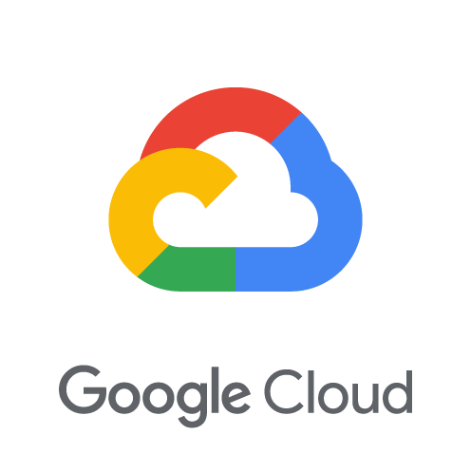

Azure Arc Architecture
Management Experiences
Portal | Azure CLI | Azure SDK
Management Services
Monitoring | Update | Backup | Security Center | More…
Azure Resource Manager
Environments and automation
Templates | Extensions
Access and security
RBAC | Locks | Subscriptions
Organization and inventory
Search | Index | Groups | Tags
Governance and compliance
Logs | Policy | Blueprints
Azure Arc-enabled servers RP
Azure Arc-enabled Kubernetes RP
Container Registry
Azure Arc-enabled data services RP
Azure Arc
server agent
Azure Arc
server agent
Azure Arc
Kubernetes agent
Azure PaaS
Control
Azure Arc data manager
Monitoring & Logs | Backup | Scaling
Provisioning | Patching | HA/DR | API
VM extensions
Monitoring
Kubernetes API
GitOps
Manager
SQL
PostgreSQL
Virtual/physical servers
Customer locations
Resource specific tools
Server Admin Tools
Kubernetes Native Tools
kubectl | Provisioning | Monitoring | Lifecycle
Git Repo
Azure Data Studio

Slide 50
Azure Arc Architecture
Customer locations (on-premises/clouds)
Resource specific tools
Management Interfaces
Azure Resource Manager (ARM)
Azure data services
Azure Data Studio
Azure Arc Data Resource Provider (RP)
Azure Arc Data Agent
Azure Portal
Identity
Azure CLI
Kubernetes Cluster
K8s Native Tools
Azure SDK
RBAC
Container Registry
Azure Arc Data Controller
Cluster provisioning​
Cluster upgrade and patch management​
Cluster lifecycle management​
Cluster monitoring
Policy
Azure Arc K8s
Resource Provider (RP)
Index
GitOps Manager
Azure PaaS Control
Azure Arc K8s Agent
Groups
Azure Arc Server Resource Provider (RP)
Servers
Etc.
Linux
Server Admin Tools
Azure Arc Server Agent
Windows Server
Azure Arc Components
Notes:
This is the architecture for Azure Arc all-up.
On the left side, we have the Azure Resource Manager in Azure as well as the resource providers for Azure Arc. On the right side, we have the Arc agents deployed on your infrastructure in your location, which sent heartbeat signals up into Azure.
We also enable you to continue to use the management tools you are familiar with, whether that’s Server admin tools, K8s cluster management tools, DevOps tools or Azure Data Studio for managing the data assets.

Slide 51
GitOps – Definition & Principles
Git as the source of truth for a system
Git as the single place where we operate
(create, change, and delete)
All changes are observable
System state described declaratively
State declaration versioned in source control
Approved changes are applied automatically
Agents enforce desired state
https://www.weave.works/technologies/gitops/
Notes:
Azure Arc enabled Kubernetes adopts a GitOps methodology, so customers define their applications and cluster configuration in source control. This means changes to apps and configuration are versioned, enforced, and logged across any number of clusters.
Let’s explore some of the principles of GitOps :
Single source of truth – Git
All actions taken by developers/admins – create, change and delete happens in Git
All changes are visible to project teams and can be tracked
Declarative Configuration: All resources managed through a GitOps process must be expressed declaratively.
Version controlled, immutable storage: The declarative descriptions are stored in a repository that supports immutability, versioning and version history. For example, git.
Automated delivery: Delivery of the declarative descriptions, from the repository to runtime environment, is fully automated.
Software Agents: Reconcilers deploy and maintain the resources described in the declarative configuration. Actions are performed on divergence between the version controlled declarative configuration and the actual state of the target system.

Slide 52







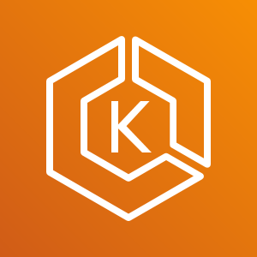


Azure Arc enabled Kubernetes GitOps Flow
Arc Connected
Kubernetes Cluster
GitOps
Configurations
Flux Operator +
Helm Operator
4
git
Repository
1
2
3
Google Kubernetes
Engine (GKE)
Flux
pickup changes
Application
Rolling Update
Azure Kubernetes Service on HCI
8
7
Application
Deployment
git merge
5
6
Elastic Kubernetes Service (EKS)
Application V2
(New Desired State)
Application V1
(Desired State)
Application
Changes
Rancher K3s
Any Kubernetes,
any Infrastructure
Notes:
So what does the GitOps flow look like in the context of Arc enabled Kubernetes?
We are starting with Kubernetes clusters outside of Azure
Azure Arc Kubernetes connected cluster is created
User creates cluster’s GitOps configurations
Flux operator gets deployed on the cluster, and starts ”listening” to the git repository with the user’s application code
Flux operator initiates user’s application deployment on the cluster, representing the current desired state
User is updating the application (creating a new app version) and merge changes to the repository
Flux pickup a change to the git repository
Flux operator initiates a new user’s application version deployment on the cluster while removing old version application pods, resulting in a new Desired State

Slide 53










Azure Arc-enabled servers Connectivity Options
Public endpoint via direct connection
Public endpoint via proxy server
Private endpoint over Express Route – In Preview
ARM
AAD
Azure Arc Service
Public Endpoint
Private Endpoint
AzureArcInfrastructure
Service tag
Internet
Azure Arc-enabled Server
Private Link
Proxy
Azure Express Route &
Site-to-Site VPN
Azure VNET

Slide 54


Azure Arc-enabled servers architecture Linux OS
Azure AD
Azure Automation
Azure Monitoring
Azure Security Center
Azure Sentinel
System Administrator
Azure Resource Manager
(ARM)
Hybrid Identity Service
Hybrid Compute Resource Provider
Guest Configuration Resource Provider
Log Analytics Workspace
HTTPS/443
On-premises/other clouds
Azure Arc Connected Machine Agent
Hybrid Instance Metadata Service
Guest Configuration
Extension Manager
/var/opt/azcmagent/
/var/lib/GuestConfig
Log Analytics Agent
Custom Script
/var/opt/azcmagent/tokens
DSC
Microsoft Dependency Agent
/opt/GC_Ext/downloads
/var/lib/waagent/<extension>

Slide 55
Azure Arc-enabled servers architecture Windows OS
Azure AD
Azure Automation
Azure Monitoring
Azure Security Center
Azure Sentinel
System Administrator
Azure Resource Manager
(ARM)
Hybrid Identity Service
Hybrid Compute Resource Provider
Guest Configuration Resource Provider
Log Analytics Workspace
HTTPS/443
On-premises/other clouds
Azure Arc Connected Machine Agent
Hybrid Instance Metadata Service
Guest Configuration
Extension Manager
%ProgramFiles%\AzureConnectedMachineAgent
%SystemDrive%\Program Files\ArcConnectedMachineAgent\ExtensionService\GC
Log Analytics Agent
Custom Script
%ProgramData%\AzureConnectedMachineAgent
%ProgramData%\GuestConfig
DSC
%ProgramData%\AzureConnectedMachineAgent\Tokens
Microsoft Dependency Agent
%ProgramData%\AzureConnectedMachineAgent\Config
%SystemDrive%\AzureConnectedMachineAgent\ExtensionService\downloads
%SystemDrive%\Packages\Plugins\<extension>>

Slide 56

Azure Arc-enabled servers Connected Machine Agent
Azure Admin
Azure Arc Connected Server (On-Premises, AWS EC2, etc.)
Azure Arc Connected Machine Agent
Azure Portal
Az CLI
Azure SDK
REST API
HTTPS/443
Azure AD
Configuration passed to the Agent:
Subscription and resource group
Azure Region to store metadata
Network options (direct, proxy, or private link)
Credential to onboard (device login, AAD token, or SPN)
Authentication & Authorization
Azure Resource Manager (ARM)
Hybrid Instance Metadata Service (HIMDS)
Handles managed identity and metadata sync (heartbeats)
HTTPS/443
Hybrid Compute
Resource Provider
Guest Configuration
Provides In-Guest Policy and Guest Configuration functionality, such as assessing whether the machine complies with required policies
HTTPS/443
Guest Configuration
Resource Provider
Extension Manager
Manages VM extensions, including install, uninstall, and upgrade
Custom Script
ASC
MMA/AMA
HTTPS/443
Log Analytics

Slide 57




Azure Arc-enabled servers Azure Key Vault Integration
System / Security Administrator
1b
Public Key Infrastructure (PKI)
AKV is configured with Azure Managed Identity for allowing the Azure Arc-enabled server to access certificates
Azure AD
6
Upon renewal time, the certificates are renewed only in AKV
(renewed PKI certs can be uploaded as well)
Azure Key Vault (AKV)
3b
AKV Extension background service
retrieve AKV certificates based on interval specified in the extension configuration
1a
User Certificates
Admin deploy Azure Key Vault
The AKV agent will then sync down the new certificate and private key automatically at its next sync interval
3a
AKV Extension background service request for
a Managed Identity token in order to retrieve certificates
Azure Arc-enabled server
2a
2b
AKV extension is deployed on the
Azure Arc-enabled server
Hybrid Compute
Resource Provider
Certificates URIs are used as parameters and syncs based on user-defined time intervals
App/Service
(i.e. Web Server)
Extension Service
AKV Extension Background Service
App/Service consumes local cert store certificate
(as well rebind upon renewal)
5
4
The certificates and private keys are stored in the local certificate store (Windows) or as files in a directory (Linux)
Cert Store

Slide 58
Azure Arc-enabled Kubernetes Onboarding
K8s Cluster Admin
Microsoft Container Registry
Azure AD
3f
1
3e
Create Service Principal in AAD
5b
az connectedk8s connect
Create Managed Identity
Managed Identity Service
Fetch the identity certificate
Hybrid Identity Service
Fetch Helm chart
2
Azure CLI
Azure Resource Manager
(ARM)
4
Send identity metadata
3d
6d
PUT resource Microsoft.Kubernetes/connectedClusters with public key (management.azure.com)
Microsoft.Kubernetes
Resource Provider (RP)
Update cluster metadata
Azure Arc-enabled Kubernetes Data Plane Service
PUT connectedCluster resource
along with Managed Identity metadata
3g
6c
Pull agent images
Push cluster metadata
(uses Managed Identity to authenticate eastus.dp.kubernetesconfiguration.com)
3c
On-Premises/Cloud Provider Kubernetes Cluster
6a
API Server
Fetch cluster metadata and update custom resource
Cluster Metadata Operator
3a
Uses Helm to deploy Arc-enabled
k8s agents with onboarding
private key
3b
6b
Save state/
Onboarding private key
in k8s datastore
Watch for updates in cluster
metadata custom resource
Resource Sync Operator
etcd
5a
Save the Azure Identity Certificate
5c
Cluster Identity Operator
Fetch connectedCluster Managed Identity certificate
(uses onboarding private key to authenticate eus.his.azure.com)

Slide 59
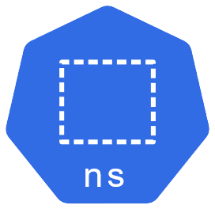
Azure Arc-enabled Kubernetes GitOps Configuration
Admin
3
4
PUT sourceControlConfiguration resource
Store sourceControlConfiguration resource
1
Azure Resource Manager
(ARM)
Microsoft.KubernetesConfiguration
Resource Provider (RP)
Azure Arc-enabled Kubernetes Dataplane Service
az k8s-configuration create
Azure CLI
5
13
GET Pending sourceControlConfiguration resources
(uses Managed Identity to authenticate)
POST status for the Flux agents
to be retrieved with resource GET
2
PUT resource
Microsoft.Kubernetes/connectedClusters/clusterName/providers/Microsoft.KubernetesConfiguration/sourceControlConfigurations/configName
(uses ARM Extension Resource pattern)
On-Premises/Cloud Provider Kubernetes Cluster
Git Repository
6
Create gitconfigs CR
Config Agent
YAML Files
Helm Releases CRs
Namespace
12
obj-x
Collect Status from Flux
7
helmreleases CR
release-a
gitconfigs CR
config-a
Watch gitconfig CRs
controller-manager
9
obj-y
Helm Release
Flux watches Git repo, creates k8s resources
based on raw YAML
and helmreleases CRs
8
Create or update
Flux Operator or
Flux-Helm Operator
obj-z
10
Flux-Helm Operator
Flux Operator
Flux-logs
agent
Flux-Helm Operator watches helmreleases CRs,
pulls Helm chart and creates Helm release
Flux events sent to upstream service
11

Slide 60


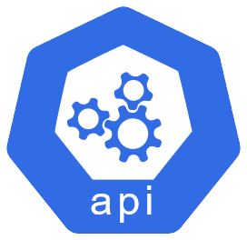



Azure Arc-enabled Kubernetes AAD RBAC (public preview)
Owner
Role assignment in Azure
checkAccess
allowed/denied
Azure Arc-enabled Kubernetes Cluster
TokenAccessReview,
SubjectAccessReview
Azure AD Entity
(User Account/Service Principal)
kubectl get pods
API Server
Guard
If allowed, return list of pods
allowed/denied
Notes:
Public Preview end of March 2021

Slide 61

Azure Arc-enabled Kubernetes Cluster Connect (public preview)
Customer Location
(On-Premises/Cloud Provider)
Azure Resource Manager (ARM)
Microsoft.Kubernetes
Resource Provider (RP)
listClusterUserCredentials
Kubernetes Cluster
az connectedk8s proxy
Client-side proxy
Hybrid Connections
Customer
Firewall
Cluster connect-agent
kube-aad-proxy
API
Server
Azure AD Entity
(User Account/Service Principal)
Dataplane Service
heartbeat
Notes:
Public preview end of March 2021

Slide 62
Azure Arc-enabled Kubernetes Cluster extensions (public preview)
6
GET version
Azure Container Registry or
Microsoft Container Registry
Admin
3
4
PUT extension resource
Store extension resource
1
Azure Resource Manager
(ARM)
Microsoft.KubernetesConfiguration
Resource Provider (RP)
Azure Arc-enabled Kubernetes Data Plane Service
az k8s-extension create
Azure CLI
5
GET Pending extension resources
(uses Managed Identity to authenticate)
12
9
2
Fetch Helm chart
stored as OCI artifact
PUT resource
Microsoft.Kubernetes/connectedClusters/clusterName/providers/Microsoft.KubernetesConfiguration/extensions/extensionName
(uses ARM Extension Resource pattern)
POST extension status
On-Premises/Cloud Provider Kubernetes Cluster
7
Create extensionconfig CR
Config Agent
Namespace
11
obj-x
Collect Status
8
extensionconfigs CR
extension
Watch extensionconfig CRs
extension-manager
obj-y
Helm Release
Install helm chart
10
obj-z
Notes:
Currently Azure Arc-enabled Kubernetes supports add-on scenarios like Azure Monitor and Azure Policy (Gatekeeper) via manual installation of Helm charts. With cluster extensions, the lifecycle of the add-ons are managed using ARM APIs
The new Cluster Extensions feature provides management experience (via CLI, Azure portal and API) to deploy and configure integrated services like Azure Monitor and Azure Defender. Users can now install and remove, configure auto upgrades, choose release trains, and securely pass in configuration settings without risking secret exposure – all using Azure APIs.
More new extensions for Azure Policy (Gatekeeper), Open Service Mesh are coming soon.
Public Preview of cluster extensions + Azure Monitor + Azure Defender – March 31

Slide 63





Azure Arc-enabled Kubernetes Azure Monitor (public preview)
Azure Monitor for containers
Workbooks
Log Analytics
Alerts
Send metrics and logs
Azure Arc-enabled Kubernetes Cluster
node-1
node-2
node-n
oms-agent
oms-agent
oms-agent
Collect metrics
and logs
Collect metrics
and logs
Collect metrics
and logs
pod-a
pod-b
pod-a
pod-b
pod-a
pod-b
pod-c
pod-d
pod-c
pod-d
pod-c
pod-d
create

Slide 64

Azure Arc-enabled Kubernetes Azure Defender (public preview)
Continuous discovery of Arc-enabled Kubernetes instances
Azure Security Center
Defender for Kubernetes
Admin
Actionable recommendations for security best practices
Detect threats across multi cloud Kubernetes clusters using advanced analytics
Log Analytics
Send audit logs
2
Azure Arc-enabled Kubernetes cluster
Control plane nodes
Worker nodes
node-1
node-2
node-n
azure-defender
pod-a
pod-b
pod-a
pod-b
Collect audit logs
1
pod-c
pod-d
pod-c
pod-d
Audit logs
apiserver
pod-e
pod-f
pod-e
pod-f
create

Slide 65

Azure Arc-enabled Kubernetes Open Service Mesh (Preview)
Azure Arc-enabled Kubernetes cluster
arc-osm-system namespace
osm-controller pod
apiserver
pod-1
Proxy control plane
Certificate manager
application
Discovery service
osm-config ConfigMap
envoy
gRPC stream
Mesh Catalog
Endpoints provider
osm-controller ValidatingWebhookConfiguration
pod-2
gRPC stream
application
osm-injector MutatingWebhookConfiguration
envoy
Mesh specification
osm-injector
Deployment
SMI API
osm-injector
Service
create

Slide 66

Azure Arc-enabled Kubernetes Azure Policy (Gatekeeper)
Azure Policy Service
Azure Arc-enabled Kubernetes Cluster
Pod
Service
CRD
PolicyTemplate CRD
Deployment
Ingress
Config
PolicyInstance CRD
Fetch policy definitions & assignments
&
Report compliance
watch
create
AdmissionReview request
Gatekeeper
Calling entity
kubectl apply –f privileged.yaml
API Server
deploy
azure-policy-addon
AdmissionReview response allowed: false
OPA
Denied
create
Notes:
Azure Policy deployment to the cluster is done today via script + Helm based onboarding. Cluster extension for Azure Policy is not yet available but under development.

Slide 67



Azure Arc-enabled Data Services Security (1 of 2)
Azure Control Plane
Secure by default configuration
Non-root containers
Least privilege deployment configuration
Security enabled via HTTPS/TLS/SSL for external endpoints
System managed certificates
Directly connected mode
Azure RBAC integration
Azure AD Authentication for management operations
Azure Active Directory
Azure CLI
Azure Data Studio
Kubernetes tools
Browser
HTTPS
HTTPS
HTTPS
Kubernetes API
Azure Arc
Data Controller
Metrics & Logs Dashboards
Any Kubernetes Cluster

Slide 68
Azure Arc-enabled Data Services Security (2 of 2)
Azure Arc-enabled SQL Managed Instance
Encryption at rest – Transparent Data Encryption
SSL/TLS encryption on the wire
SQL login or Active Directory authentication
Azure Arc-enabled PostgreSQL Hyperscale
Encryption with pgcrypto extension
Audit with pgaudit extension
Azure Data Studio, Tools & Apps/Drivers
Azure Data Studio, Tools & Apps/Drivers
Active directory
TCP with SSL
TCP with SSL/TLS
Azure Arc-enabled Data Services
Azure PostgreSQL
Hyperscale
Azure SQL Managed Instance

Slide 69

Arc Data Services Maintenance updates
Directly Connected Mode
Azure Based System Maintenance Window Updates
Flexibility to choose your Maintenance Windows
Indirectly Connected Mode
Single Maintenance Window for all services
Rolling upgrades without application downtime
K8s Worker Node
Data Controller
K8s Worker Node
K8s Worker Node
K8s Worker Node
K8s Worker Node
K8s Worker Node
K8s Worker Node
Pod
Pod
Pod
Pod
Pod
Pod
Availability
Group
Availability
Group
SQL MI
Primary
SQL MI
Primary
SQL MI
Secondary
SQL MI
SQL MI
SQL MI
Primary
SQL MI
SQL MI
Secondary
SQL MI
Primary
SQL MI
Secondary
SQL MI
Secondary
SQL MI
SQL MI
Secondary
State: Unpatched
State: Patching
State: Patched
State: Unpatched
State: Patching
State: Patching
State: Unpatched
State: Patching
State: Patched
State: Unpatched
State: Unpatched
State: Unpatched
State: Unpatched
State: Patching
State: Unpatched

Slide 70
Point-In-Time Restore [PITR]
Simple enablement of Point in Time Restore
Highly configurable settings during create
PITR settings:
Recovery Point Objective as frequently as every 5 minutes, default is 15 minutes
Backup retention time is 7 days by default
Storage settings:
Storage class where backups will be stored
Volume size for the backup volume
Optionally create a persistent volume just for backups
Simplified Restore Operations
Simply specify point in time to restore to
Long term retention data can be sent to Azure storage
Azure Data Studio
Kubernetes
Node
Node
Node
Persistent Storage

Slide 71
Scaling: Azure Arc-enabled SQL Managed Instance
Scale up via Azure portal and CLI cmd:
Increase processing power on your instances in few seconds by adding more vCores and Memory
Dynamically adjust your SQL instances capacity to match your business demand
Pay only for the resources consumed.
Set limits on how much instances can go up to
Set request are reserved instance will get entire amount allocated
Scale down:
Scale your memory and vCores down as demand decreases
Read Scale out:
Scale out your read workloads to secondary replica
Scale the same instance to match demand
Az CLI command
Azure Data Studio
2 vCores
4 GB
Scale up
16 vCores
64 GB
2 vCores
Scale down
4 GB
Available space
Used Cores/Memory

Slide 72
Scaling: Azure Arc-enabled PostgreSQL Hyperscale
PREVIEW
Scale up via Azure portal and CLI cmd :
Increase number of vCores or memory used
Granularity: coordinator or workers
Scale down:
Decrease number of vCores or memory used
Granularity: coordinator or workers
Scale out:
Increase the number of worker nodes in the server group
Distributes data and queries across workers
Scale in:
Decrease the number of worker nodes in the server group
Worker nodes
W₁
Application
W₂
Server group
Coordinator node
W₃ … W_{n}

Slide 73
Azure Arc-enabled SQL Managed Instance High Availability
Deploy Azure Arc-enabled SQL Managed Instance with 2 or 3 replicas for increased reliability and scale out performance
Automated failovers and instance redeployment in event of pod/node failure
Ability to run read workloads on secondary instances
Resources
https://docs.microsoft.com/en-us/azure/azure-arc/data/managed-instance-high-availability
Notes:
The High Availability Feature for Arc-enabled SQL Managed Instance enables you to deploy with 3 replicas (copies) of your SQL instance for increased reliability
In the event of a node/pod failure, an automated failover process will promote a secondary replica to become a new primary and automatically redirect the SQL Instance connection endpoint to the new primary. This will enable your applications to continue working without manual intervention
All 3 replicas are in sync. This will enable you to run read workloads off the secondary instances as they have an identical copy of the data to the primary instance.

Slide 74
Azure Arc-enabled data services (1 of 5)
K8s Worker Node
SQL Managed Instance High Availability
Data Controller
Built-in Setup
No other cluster technologies
Default configuration with 3 sync replicas
Primary and readable secondary endpoints
Automated Failover
K8s Worker Node
K8s Worker Node
K8s Worker Node
Pod
Pod
Pod
Availability
Group
SQL MI
Primary
SQL MI
Secondary
SQL MI
Secondary
AG agent
AG agent
AG agent
Load Balancer
Service
Web App
Notes:
Here is how SQL Managed Instance is deployed with High Availability:
First, the data controller deploys 3 SQL Managed Instances on separate nodes with additional Availability Group Agents
The 3 SQL Managed Instances form an Availability Group (AG)
The AG Agents monitor the health of the AG and manages the AG
An external endpoint enables you to connect to the SQL Managed Instance and routes you directly to the primary instance
Few additional notes:
Deploying SQL Managed Instance and setting up Availability Groups is all managed by the system. User does not need to perform additional set up steps.
There are no additional clustering technologies such as Windows Failover cluster required
The default configuration is 3 replicas with 1 primary and 2 secondary instances
There are both primary and secondary connection endpoints
Automatic failovers are handled by the system

Slide 75
Azure Arc-enabled data services (2 of 5)
K8s Worker Node
SQL Managed Instance High Availability
Data Controller
Built-in Setup
No other cluster technologies
Default configuration with 3 sync replicas
Primary and readable secondary endpoints
Automated Failover
K8s Worker Node
K8s Worker Node
K8s Worker Node
Pod
Pod
Pod
Availability
Group
SQL MI
Primary
SQL MI
Secondary
SQL MI
Secondary
AG agent
AG agent
AG agent
Load Balancer
Service
Service
Read-Only
Web App
Web App
Notes:
There is also a second connection endpoint for available for read-only workloads that directs traffic to the secondary instances of the AG

Slide 76
Azure Arc-enabled data services (3 of 5)
K8s Worker Node
SQL Managed Instance High Availability
Data Controller
Built-in Setup
No other cluster technologies
Default configuration with 3 sync replicas
Primary and readable secondary endpoints
Automated Failover
K8s Worker Node
K8s Worker Node
K8s Worker Node
Pod
Pod
Pod
Availability
Group
SQL MI
Primary
SQL MI
Secondary
SQL MI
Secondary
AG agent
AG agent
AG agent
Load Balancer
Service
Service
Read-Only
Web App
Web App
Notes:
There is also a second connection endpoint for available for read-only workloads that directs traffic to the secondary instances of the AG

Slide 77
Azure Arc-enabled data services (4 of 5)
K8s Worker Node
SQL Managed Instance High Availability
Data Controller
Built-in Setup
No other cluster technologies
Default configuration with 3 sync replicas
Primary and readable secondary endpoints
Automated Failover
K8s Worker Node
K8s Worker Node
K8s Worker Node
Pod
Pod
Pod
Availability
Group
SQL MI
Primary
SQL MI
Primary
SQL MI
Secondary
AG agent
AG agent
AG agent
Load Balancer
Service
Service
Read-Only
Web App
Web App
Notes:
There is also a second connection endpoint for available for read-only workloads that directs traffic to the secondary instances of the AG

Slide 78
Azure Arc-enabled data services (5 of 5)
K8s Worker Node
SQL Managed Instance High Availability
Data Controller
Built-in Setup
No other cluster technologies
Default configuration with 3 sync replicas
Primary and readable secondary endpoints
Automated Failover
K8s Worker Node
K8s Worker Node
K8s Worker Node
Pod
Pod
Pod
Availability
Group
SQL MI
Secondary
SQL MI
Primary
SQL MI
Secondary
AG agent
AG agent
AG agent
Load Balancer
Service
Service
Read-Only
Web App
Web App
Notes:
There is also a second connection endpoint for available for read-only workloads that directs traffic to the secondary instances of the AG

Slide 79
Arc-enabled Azure SQL Managed Instance
High Availability and Disaster Recovery using Availability Groups
K8s Worker Node
K8s Worker Node
Data Controller
Data Controller
K8s Worker Node
K8s Worker Node
K8s Worker Node
K8s Worker Node
K8s Worker Node
K8s Worker Node
Distributed
Availability
Group
Pod
Pod
Pod
Pod
Pod
Pod
Availability
Group
Availability
Group
SQL MI
Primary
SQL MI
Secondary
SQL MI
Secondary
SQL MI
Primary
SQL MI
Secondary
SQL MI
Secondary
AG agent
AG agent
AG agent
AG agent
AG agent
AG agent
Read-Write
Read-Only
Read-Write
Read-Only
Load Balancer
Load Balancer
R/W K8s Service
R/O K8s Service
R/W K8s Service
R/O K8s Service
Disaster Recovery (DR)
Multiple K8s clusters
App
App
App
App
Primary connections
DNS routing
DR connections
High Availability (HA)
Single K8s cluster – multiple nodes in Datacenter 1 (Primary Site)
Application clients
High Availability (HA)
Single K8s cluster – multiple nodes in Datacenter 2 (DR Site)

Slide 80
High availability for Arc-enabled PostgreSQL
Primary
SQL
Health checks
PREVIEW
Application
Streaming replication
Monitor
SQL (fallback)
Secondary
Health checks
Based on pg_auto_failover extension
Supports multiple secondaries
Failover at the Postgres coordinator/worker level
W₁
Worker 1 Primary
W₁
Worker 1 Secondary
COORDINATOR Primary
W₁
Worker 2 Primary
Application
Server group
W₁
Worker 2 Secondary
COORDINATOR Secondary
W₁
Worker n Primary
Monitor
W₁
Worker n Secondary

Slide 81
Azure Arc-enabled Data Services Endpoints
azdata CLI
Kubernetes tools
azdata CLI
Browser
Azure Data Studio
PostgreSQL tools & drivers
Azure Data Studio
SQL tools & drivers
HTTPS
HTTPS
HTTPS
TCP
TCP
Any Kubernetes Cluster
Azure Arc Data Control Plane
Azure Arc Data Control Plane
Azure Arc-enabled data services
Kubernetes API
Azure Arc Data Controller
Metrics & Logs UI
Azure PostgreSQL Hyperscale
Azure SQL Managed Instance

Slide 82








Fabrikam Azure Tenant
Virtual Machines
Storage
Network
App Services
Kubernetes
Service
Data
Services
Cosmos DB
Functions
Azure Arc-enabled infrastructure & services
Azure Arc
Azure Arc
SQL Server
Azure Arc
SQL Managed
Instance
Azure Arc
PostgreSQL
Hyperscale
Azure Arc
SQL Server
Azure Arc
SQL Managed
Instance
Azure Arc
PostgreSQL
Hyperscale
Bare-Metal
Servers
Windows & Linux
Servers
Kubernetes
Bare-Metal / VM
AWS
EC2
Elastic
Kubernetes
Service (EKS)
GCP
Instance
Google
Kubernetes
Engine (GKE)
Azure Arc Data Controller
Azure Arc Data Controller
Fabrikam On-Premises Datacenter
Fabrikam Multi-Cloud Workloads
Notes:
To wrap it all-up, I think this one slide summarizes everything we’ve talked about. This also show the integration with Azure Lighthouse in a multi-tenant, multi-cloud management scenario.

Slide 83
Contoso MSP Tenant Powered by Azure Lighthouse
Access Management
Portal & Dashboarding
Policy & Governance
Monitoring
Logging & Analytics
Cost Management
Security
Patch Management
BC/DR
MSP 3rd Party
Solutions Integration
Service Health
& Support
Fabrikam Azure Tenant
Parnell Aerospace Azure Tenant
App Services
Fourth Coffee Azure Tenant
Virtual Machines
Storage
Network
Kubernetes
Service
Data
Services
Cosmos DB
Functions
Parnell Aerospace
On-Premises Datacenter
Parnell Aerospace
Multi-Cloud Workloads
Azure Arc-enabled infrastructure & services
Fourth Coffee
On-Premises Datacenter
Fourth Coffee
Multi-Cloud Workloads
Azure Arc
Azure Arc
SQL Server
Azure Arc
SQL Managed
Instance
Azure Arc
PostgreSQL
Hyperscale
Azure Arc
SQL Server
Azure Arc
SQL Managed
Instance
Azure Arc
PostgreSQL
Hyperscale
Bare-Metal
Servers
Windows & Linux
Servers
Kubernetes
Bare-Metal / VM
AWS
EC2
Elastic
Kubernetes
Service (EKS)
GCP
Instance
Google
Kubernetes
Engine (GKE)
Azure Arc Data Controller
Azure Arc Data Controller
Fabrikam On-Premises Datacenter
Fabrikam Multi-Cloud Workloads
Notes:
To wrap it all-up, I think this one slide summarizes everything we’ve talked about. This also show the integration with Azure Lighthouse in a multi-tenant, multi-cloud management scenario.

Slide 84




Azure Stack HCI Modern Subscription for flexible, familiar, hyperconverged infrastructure
Enterprise scale and price performance
Choice of deployment options
Native integration with Azure Arc
Familiar management and operations
Notes:
Speaker Notes WIP
Native Integration with Azure Arc
Azure Stack HCI is Hybrid by design with native integration with Azure Arc. This enables the connection to Azure management services such as Azure Monitor, Azure Security Center

Slide 85
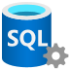
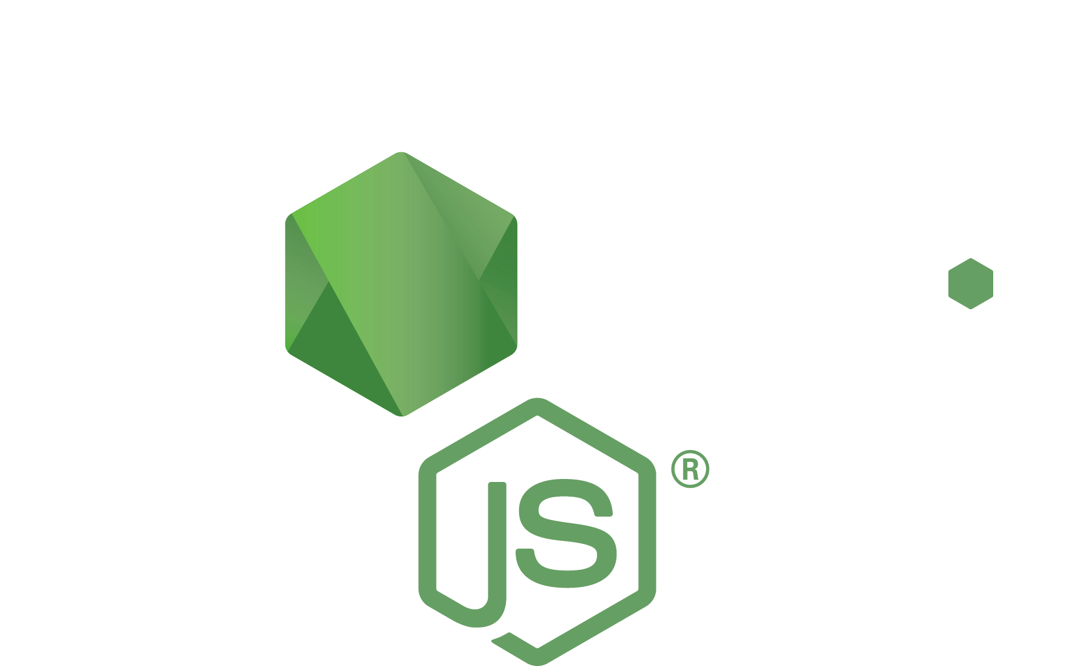
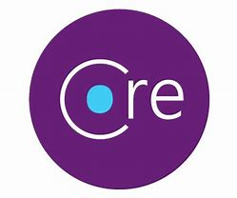

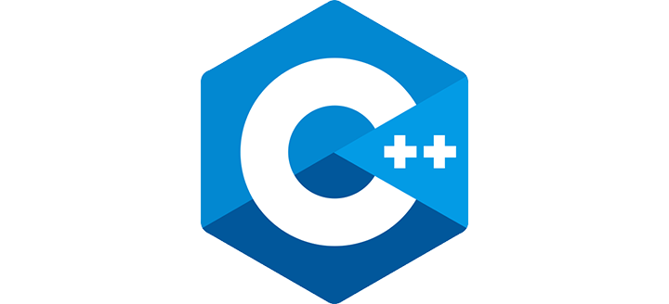
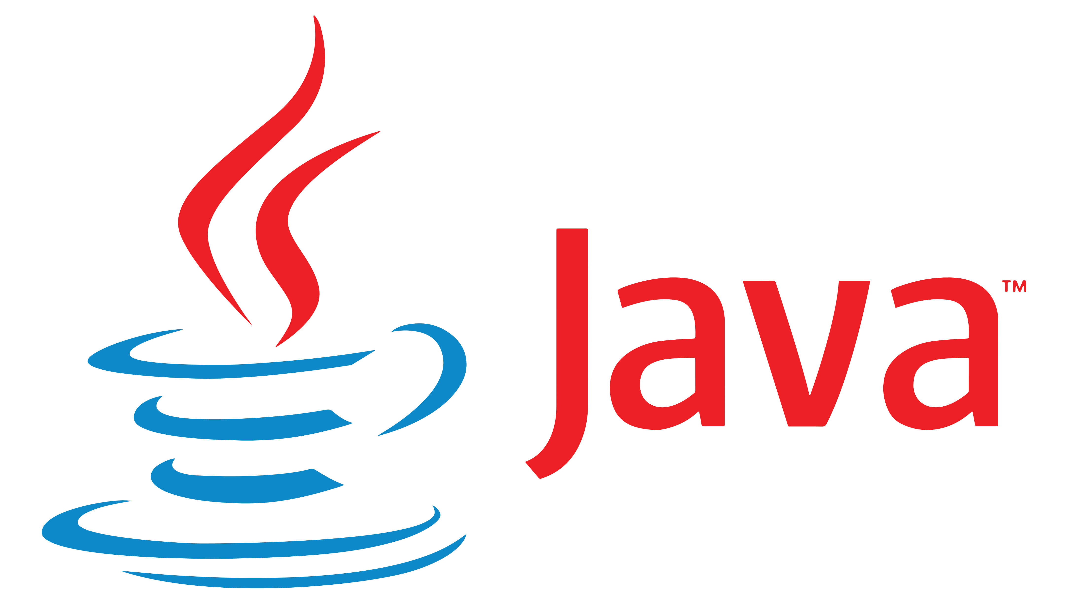


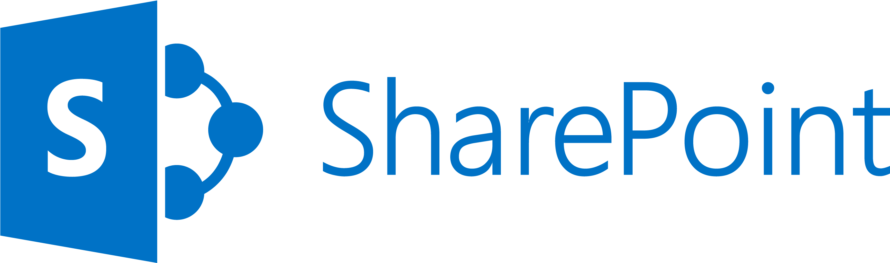



Azure Arc and Azure Stack HCI Platform architecture
Cloud-Native
Applications
Azure
Arc
Virtual Machines
Applications
Containers
Arc enabled data services
Windows/Linux VMs
AKS on Azure Stack HCI
Azure Stack HCI operating system
Hardware ecosystem

Slide 86



AKS on Azure Stack HCI Architecture
AKS-HCI Workload Cluster-01 (Azure Arc enabled Kubernetes)
Kubernetes Control Plane
Kubernetes Workload Nodes & Applications
System Services
User Applications
AKS-HCI Management Cluster
Hyper-V VM-01
Hyper-V VM-02
Hyper-V VM-03
Hyper-V VM-01
Hyper-V VM-02
Hyper-V VM-n
System Services
AKS-HCI Workload Cluster-n (Azure Arc enabled Kubernetes)
Hyper-V VM-01
Kubernetes Control Plane
Kubernetes Workload Nodes & Applications
System Services
User Applications
Hyper-V VM-01
Hyper-V VM-02
Hyper-V VM-03
Hyper-V VM-01
Hyper-V VM-02
Hyper-V VM-n
Azure Stack HCI Cluster
Physical HCI Nodes
Hyper-V
vSwitch

Slide 87

AKS on Azure Stack HCI using Azure VM (Nested Virtualization)
Azure
Resource
Group
Azure Kubernetes Service (AKS) on Azure Stack HCI
Platform Services Kubernetes Management Cluster
Kubernetes Workload Cluster
Kubernetes Control Plane
Kubernetes Worker Nodes
Hyper-V VM
System Services & Containers
Hyper-V VM
System Services & Containers
Hyper-V VM
System Services & Containers
Hyper-V VM
System Services & Containers
Hyper-V VM
System Services & Containers
Hyper-V VM
System Services & Containers
Azure VM – AKSHCI Hyper-V Host
Windows Server 2019 Datacenter with Hyper-V enabled (Nested Virtualization)
Hyper-V
vSwitch
Azure Virtual Network

Slide 88

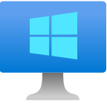



Contoso MSP Tenant Powered by Azure Lighthouse
Access Management
Portal & Dashboarding
Policy & Governance
Monitoring
Logging & Analytics
Cost Management
Security
Patch Management
BC/DR
MSP 3rd Party
Solutions Integration
Service Health
& Support
Fabrikam Azure Tenant
Parnell Aerospace Azure Tenant
App Services
Fourth Coffee Azure Tenant
Virtual Machines
Storage
Network
Kubernetes
Service
Data
Services
Cosmos DB
Functions
Parnell Aerospace
On-Premises Datacenter
Parnell Aerospace
Multi-Cloud Workloads
Azure Arc enabled infrastructure & services
Fourth Coffee
On-Premises Datacenter
Fourth Coffee
Multi-Cloud Workloads
Azure Arc
Azure Arc
SQL Server
Azure Arc
SQL Managed
Instance
Azure Arc
PostgreSQL
Hyperscale
Azure Arc
SQL Server
Azure Arc
SQL Managed
Instance
Azure Arc
PostgreSQL
Hyperscale
Bare-Metal
Servers
Windows & Linux
Servers
Kubernetes
Bare-Metal / VM
AWS
EC2
Elastic
Kubernetes
Service (EKS)
GCP
Instance
Google
Kubernetes
Engine (GKE)
Azure Arc Data Controller
Azure Arc Data Controller
Fabrikam On-Premises Datacenter
Fabrikam Multi-Cloud Workloads
Notes:
To wrap it all-up, I think this one slide summarizes everything we’ve talked about. This also show the integration with Azure Lighthouse in a multi-tenant, multi-cloud management scenario.

Slide 89
Fabrikam Azure Tenant
Virtual Machines
Storage
Network
App Services
Kubernetes
Service
Data
Services
Cosmos DB
Functions
Azure Arc enabled infrastructure & services
Azure Arc
Azure Arc
SQL Server
Azure Arc
SQL Managed
Instance
Azure Arc
PostgreSQL
Hyperscale
Azure Arc
SQL Server
Azure Arc
SQL Managed
Instance
Azure Arc
PostgreSQL
Hyperscale
Bare-Metal
Servers
Windows & Linux
Servers
Kubernetes
Bare-Metal / VM
AWS
EC2
Elastic
Kubernetes
Service (EKS)
GCP
Instance
Google
Kubernetes
Engine (GKE)
Azure Arc Data Controller
Azure Arc Data Controller
Fabrikam On-Premises Datacenter
Fabrikam Multi-Cloud Workloads
Notes:
To wrap it all-up, I think this one slide summarizes everything we’ve talked about. This also show the integration with Azure Lighthouse in a multi-tenant, multi-cloud management scenario.

Slide 90






Complete guidance for hybrid and multicloud approach
Plan
Govern
Manage
Define
Strategy
Adopt
Ready
Build skills across your team with Microsoft Learn
Accelerate deployment with Reference Architectures
Optimize workloads with Azure Well-Architected
Apply best practices to rapidly onboard
Review technical documentation on featured products
Cloud Adoption Framework
Guide your cloud journey across people, process and technology
Start with the cloud adoption framework to guide your cloud journey and build on it using the hybrid adoption scenario guidance
https://aka.ms/adopt/hybrid

Slide 91
Get started
Azure Arc-enabled servers generally available, get started today: https://aka.ms/Azure-Arc
Azure Arc-enabled Kubernetes generally available, get started today: https://aka.ms/Azure-Arc-Kubernetes
Try Azure Arc-enabled data services: https://aka.ms/hybrid-data-services
Learn more
Azure Arc
Any Infrastructure, Any Cloud
Azure Arc Jumpstart: https://aka.ms/AzureArcJumpstart
Technical documentation: https://aka.ms/AzureArcDocs
Azure Arc Learning Path: https://aka.ms/AzureArcLearn

Slide 92

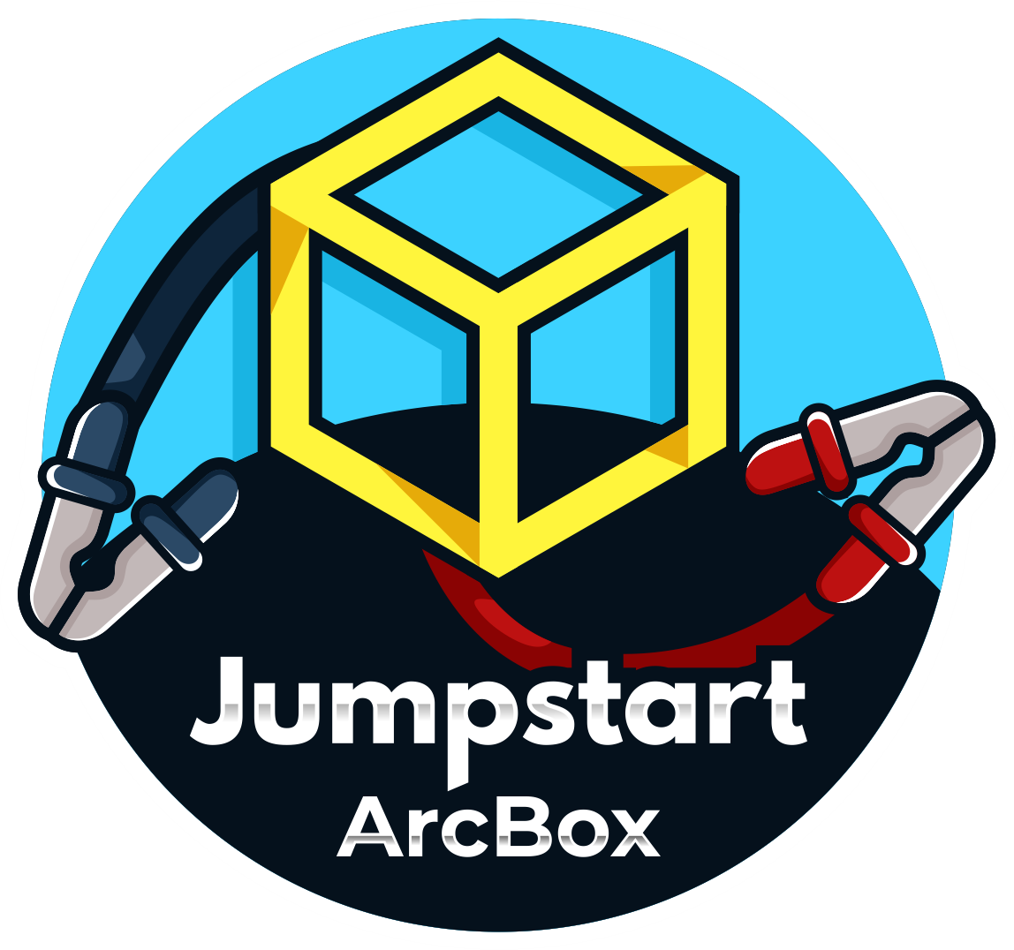

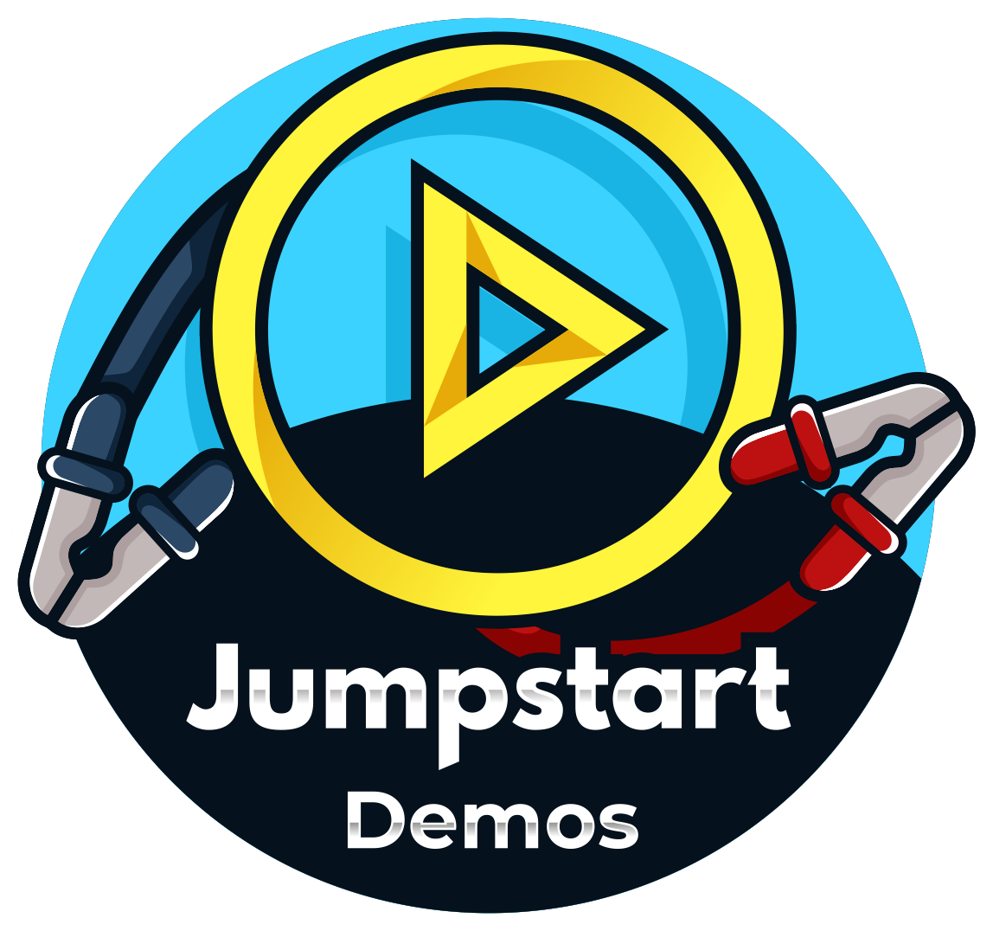
The Azure Arc Jumpstart project
Provide a “zero to hero” scenarios for multiple environments and deployment type using as much automation as possible.
Create a ”supermarket” experience by being able to take “off the shelf” scenarios and implement it.
Meeting Azure Arc customers and partners where they are.
Agile, “startup-like” team.
No detail is too small.
Ready to go technical demos
Jumpstart ArcBox is a sandbox environment that allows users to explore all the major capabilities of Azure Arc in a click of a button.
Jumpstart Lighting is a show where people come to share their Azure Arc/Jumpstart/Hybrid experience.

Slide 93
Resources
Azure Arc complete overview
Azure Arc-enabled
Kubernetes & servers
Azure Arc-enabled data services
aka.ms/arc-introvideo
Introducing Azure Arc
aka.ms/arc-compete
Azure Arc compete deck
aka.ms/azurearcpricing Azure Arc pricing page
aka.ms/arc-techcommunity
Deep dives on Azure Arc, best practices and more
aka.ms/arc-customerstories
Learn how customers are implementing Azure Arc
https://aka.ms/arc-feedback
Public Q&A forum
aka.ms/AzureArcJumpstart
Azure Arc Jumpstart
aka.ms/AzureArcJumpstartDemos
Azure Arc Jumpstart demos
aka.ms/arc-blog Azure Arc: Extending Azure management to any infrastructure
aka.ms/arc-k8svideo
Kubernetes—Managing K8 clusters outside of Azure with Azure Arc
aka.ms/arc-serversvideo
Server management—Organize all your servers outside of Azure with Azure Arc
aka.ms/arc-serversdocs
Documentation for Azure Arc enabled servers
aka.ms/arc-k8sdocs
Documentation for Azure Arc enabled Kubernetes
aka.ms/arc-datablog
Run Azure data services on-premises, at the edge, and multi-cloud with Azure Arc
aka.ms/arc-data-mechanicsvideo
Azure Arc-enabled data services demos including SQL and PostgreSQL Hyperscale
aka.ms/arc-ignite-video
Ignite 2021: Innovate across hybrid and multicloud with Azure Arc
aka.ms/arc-datadocs
Documentation for Azure Arc-enabled data services

Slide 94
Thank you

